Slide 1
Animations for:
A simple mechanical hypothesis for the diversity and speed-dependency of animal gaits
Author to be added later

Slide 2
Assumptions
Half sine-wave vertical force profiles (black) of amplitude sufficient to support weight at duty factor=0.3
acting on a body centre of mass, and imposing rolling and pitching moments on a body
for two idealised gaits: trot and rotary gallop.
Green circle denotes base of neck.

Slide 3
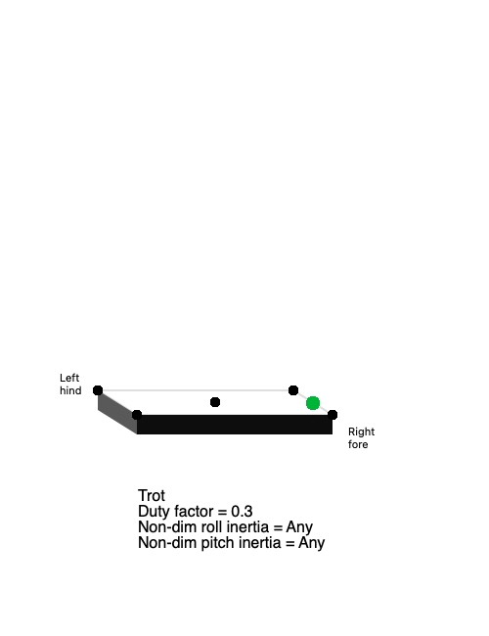
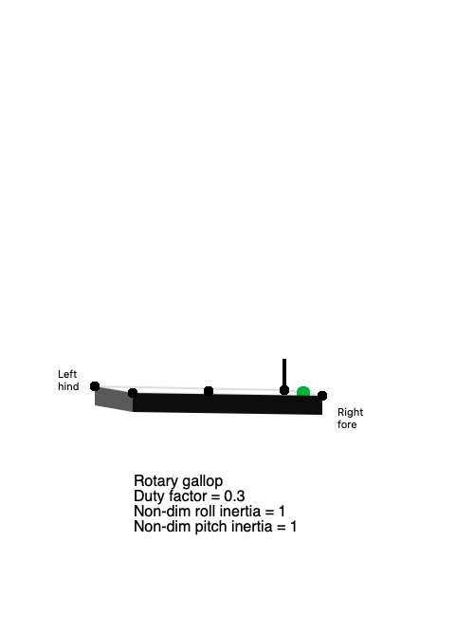
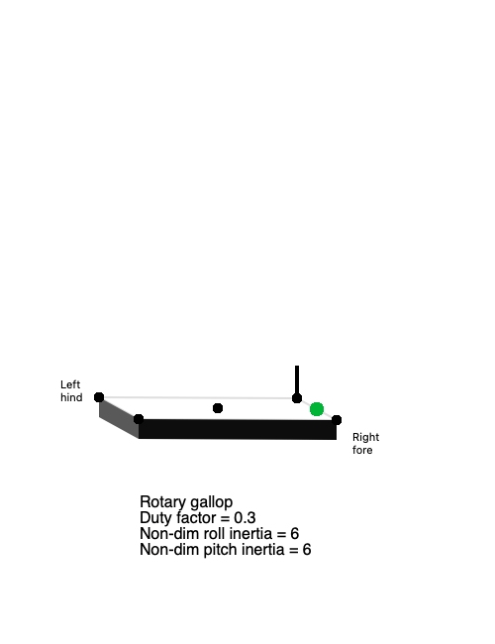
Force

Slide 4
Assumptions
Forces impose accelerations at the centre of mass
Moments impose angular accelerations, with magnitude dependent on moments of inertia
Local accelerations shown as yellow, orange if exactly gravity, red if exceeding gravity (downward)

Slide 5
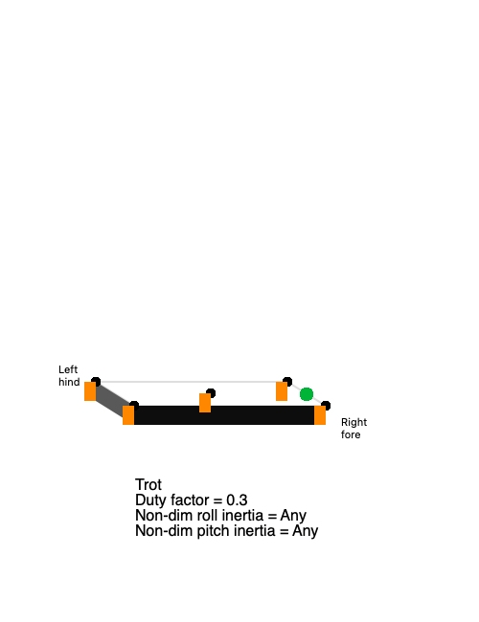
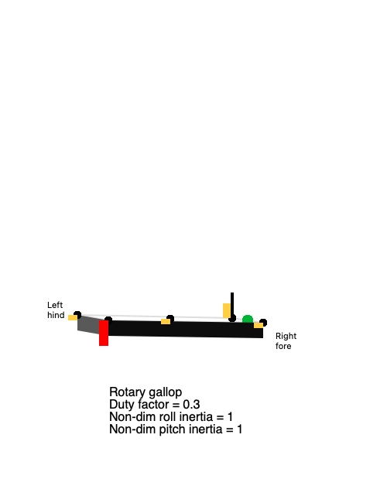
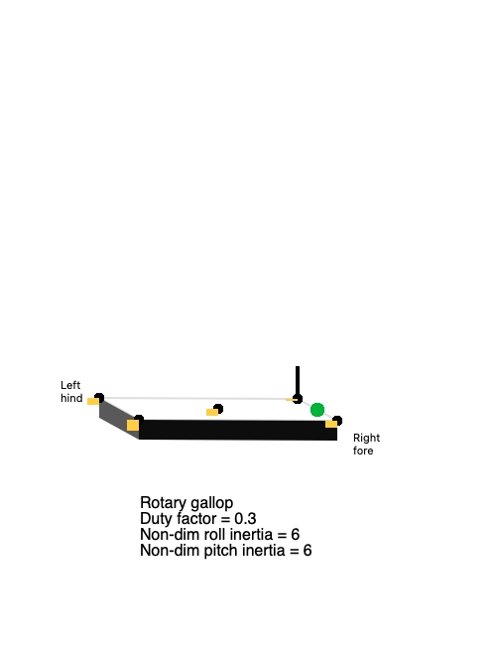
Force
Acceleration

Slide 6
Assumptions
Accelerations result in velocities at each position
Pale blue upward
Dark blue downward

Slide 7
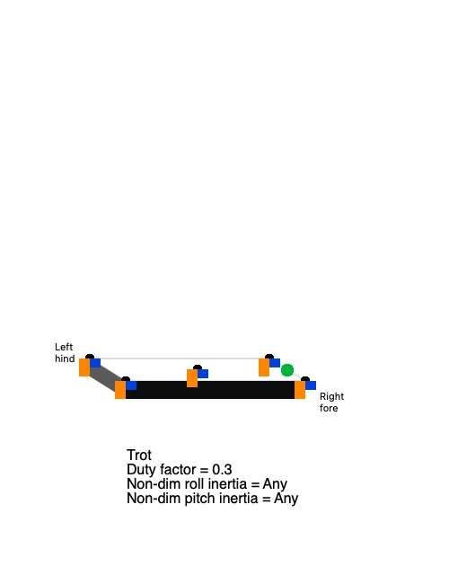
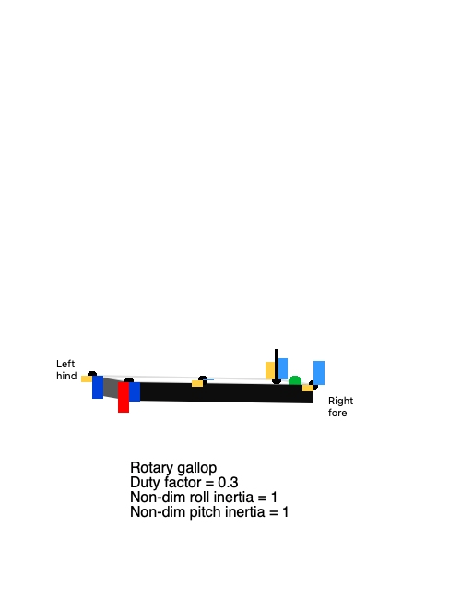

Force
Acceleration
Velocity

Slide 8
Assumptions
Force and velocity results in power demand at each position (green)
Only positive power demands are shown

Slide 9
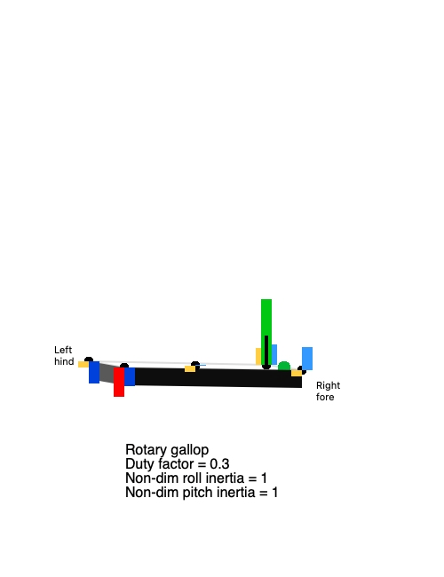
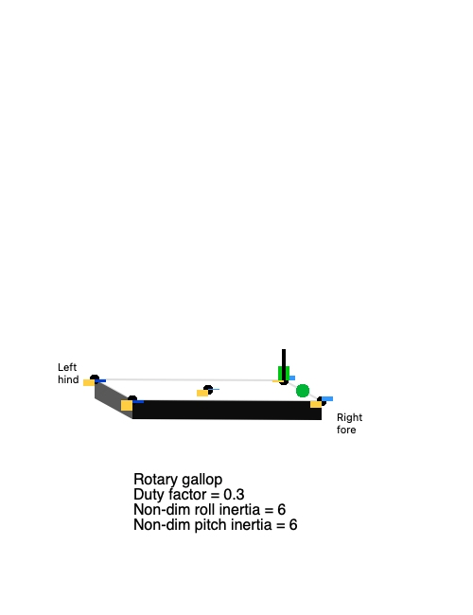
Force
Acceleration
Velocity
Power

Slide 10
Conclusion
Lower power and work demands are achieved with trot for low rotational inertia bodies;
trot avoids roll and pitch
Lowest power and work demands are achieved with rotary gallop given sufficiently high rotational inertia bodies

