Slide 1

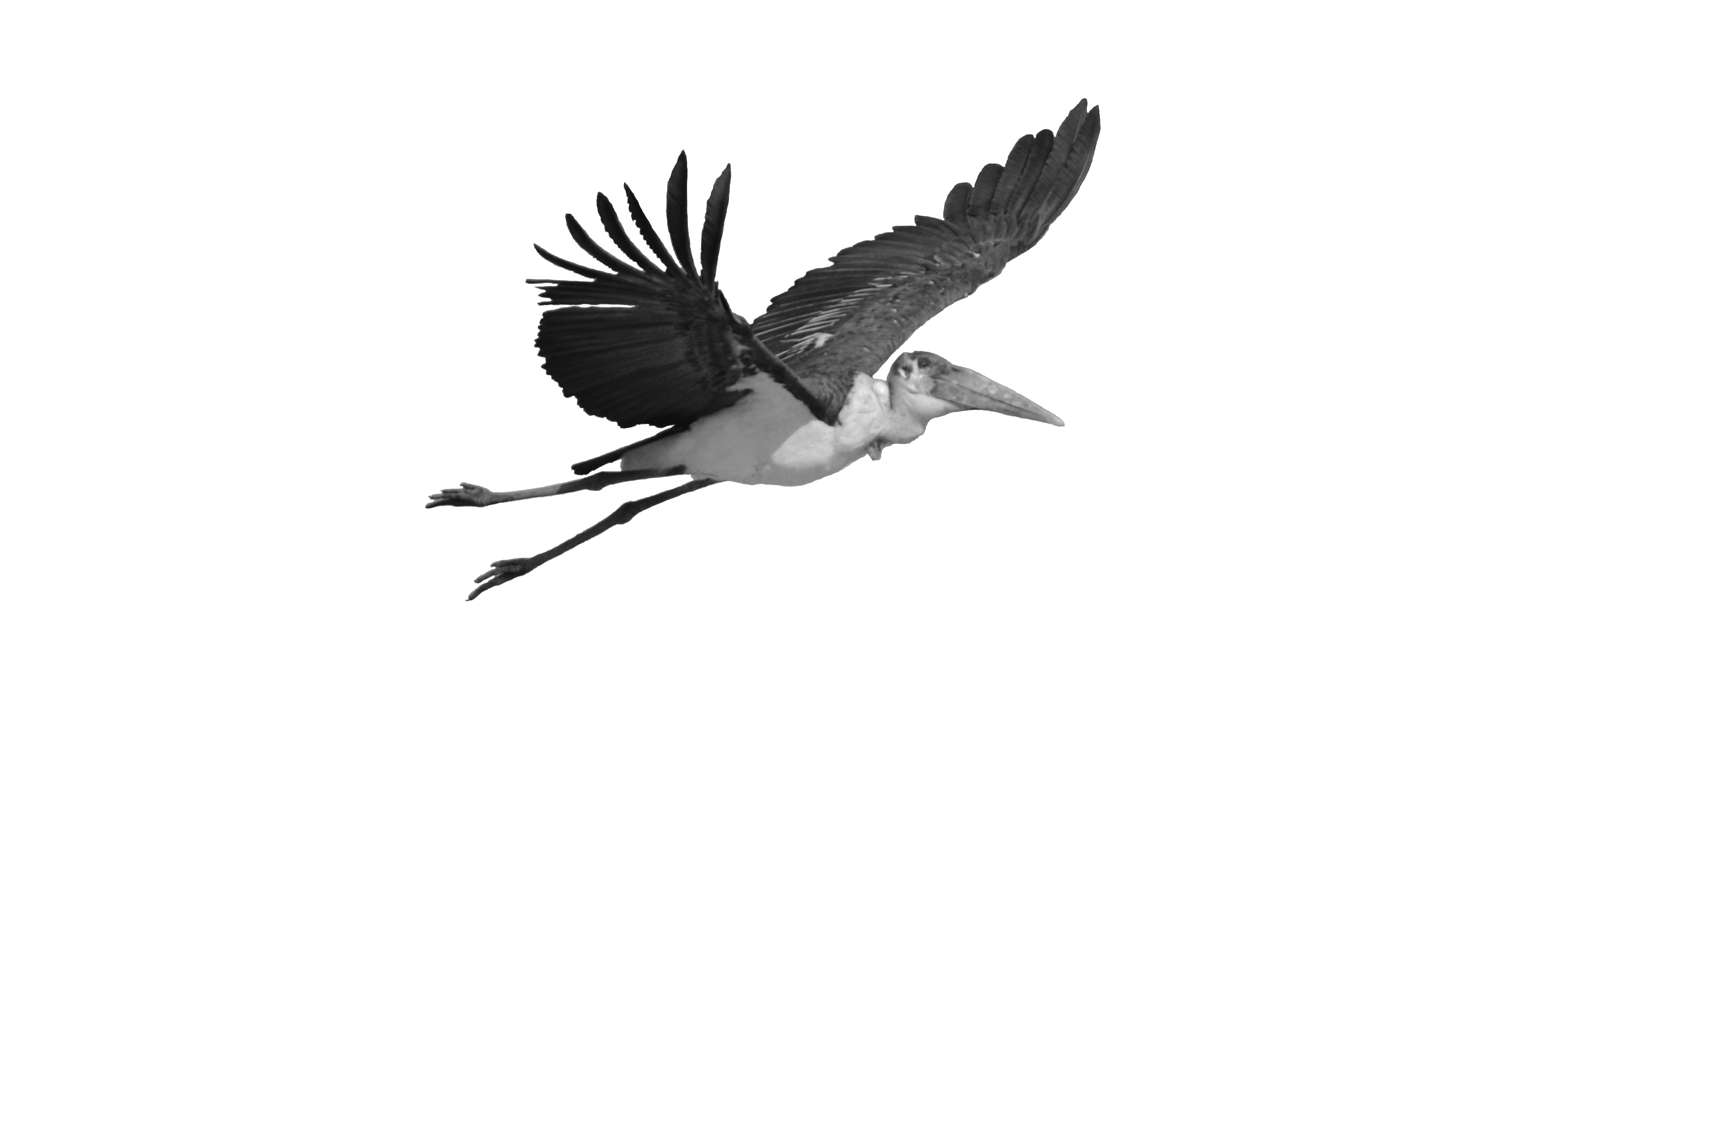
Propeller principles:
Strouhal number and the pike-tuna, vulture-swift spectrum
Usherwood, J.R. (2025). Limiting and optimal Strouhal numbers or tip speed ratios for cruising propulsion by fins, flukes, wings and propellers. J. R Soc. Interface.
Usherwood, J.R. (in press). Propeller efficiency and the spectrum of propulsor form with speed, from pike to tuna, vulture to swift. J. R Soc. Interface.
Jim Usherwood. Structure and Motion Lab., The Royal Veterinary College
JimUsherwoodResearch.com/wings-and-fins

Slide 2
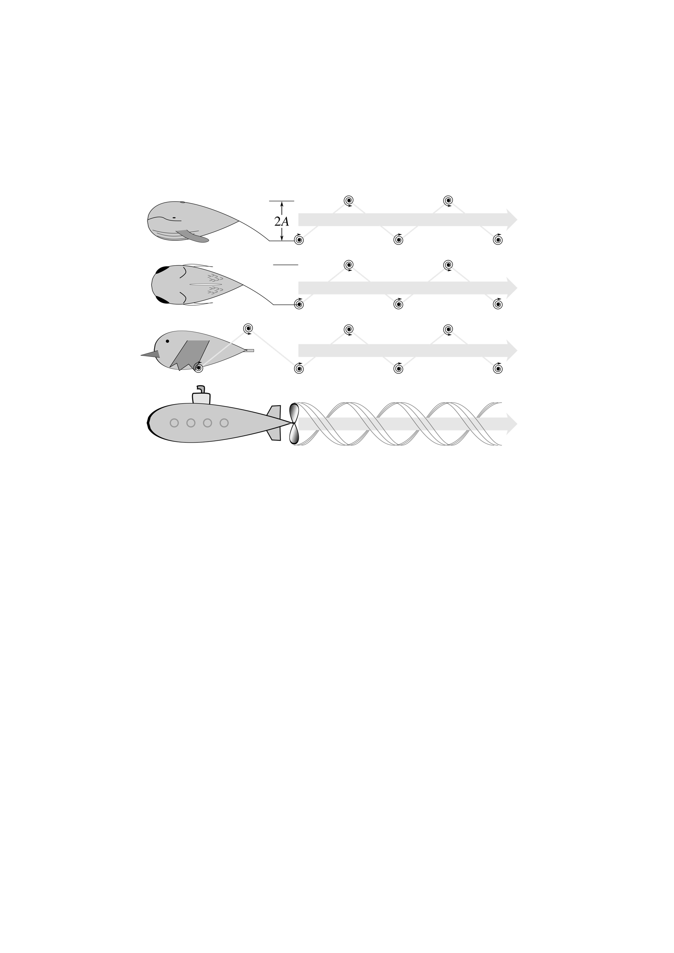
E.g. Triantafyllou, G.S., Triantafyllou, M.S. and Grosenbaugh, M.A. (1993). Optimal thrust development in oscillating foils with application to fish propulsion. J. Fluids and Structures. 7, 205-224.
Triantafyllou, M.S., Triantafyllou, G.S. and Gopalkrishnan, R. (1991). Wake mechanics for thrust generation in oscillating foils. Phys. Fluids A. 3, 2835-2837. DOI: 10.1063/1.858173

Slide 3
Taylor, G.K., Nudds, R.L. and Thomas, A.L.R. (2003). Flying and swimming animals cruise at a Strouhal number tuned for high power efficiency. Nature. 425, 707-711. doi:10.1038/nature02000.

Slide 4
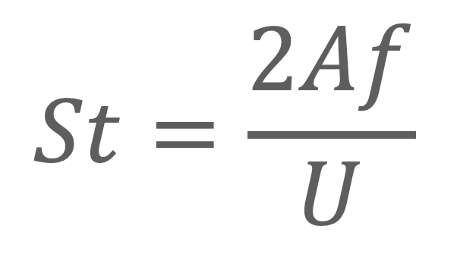
[Richard Bomphrey]
$$St=\frac{2Af}{U}$$

Slide 5
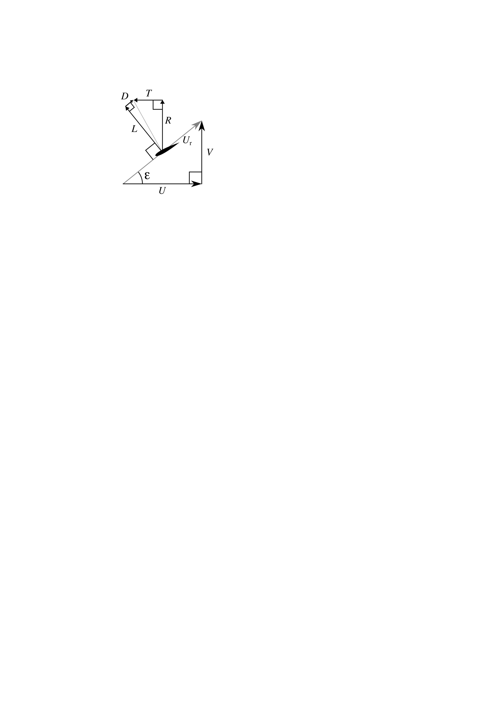

Slide 6
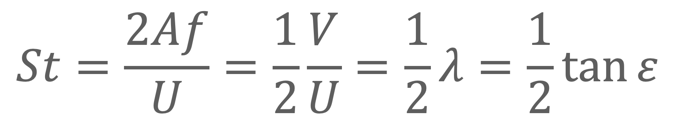
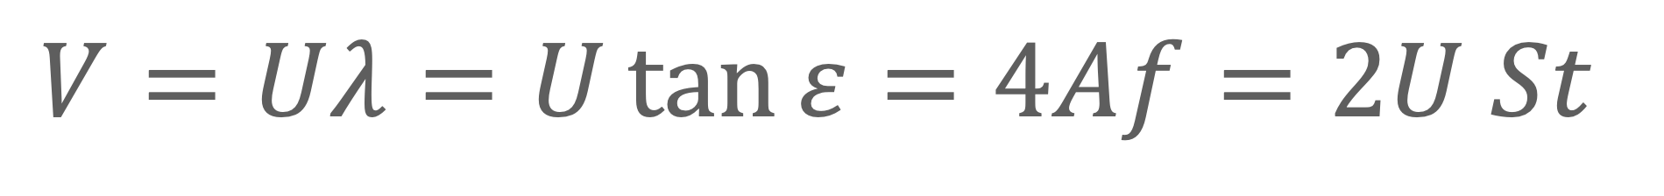
$$V=Uλ=U\tan{ε}=4Af=2U St$$
$$St=\frac{2Af}{U}=\frac{1}{2}\frac{V}{U}=\frac{1}{2}λ=\frac{1}{2}\tan{ε}$$

Slide 7
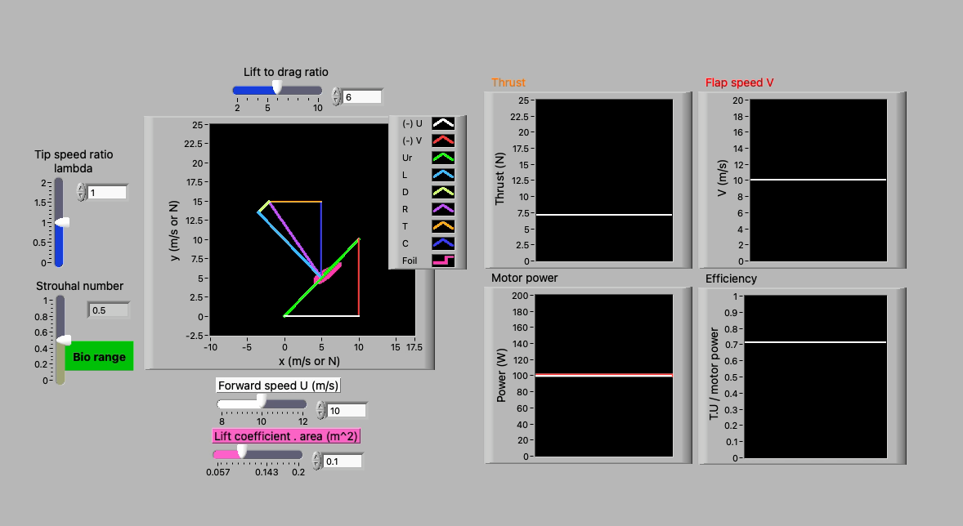
Vary LDR

Slide 8


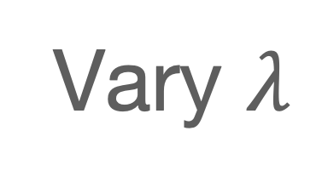
Vary $λ$
$$V=Uλ=U\tan{ε}=4Af=2U St$$

Slide 9
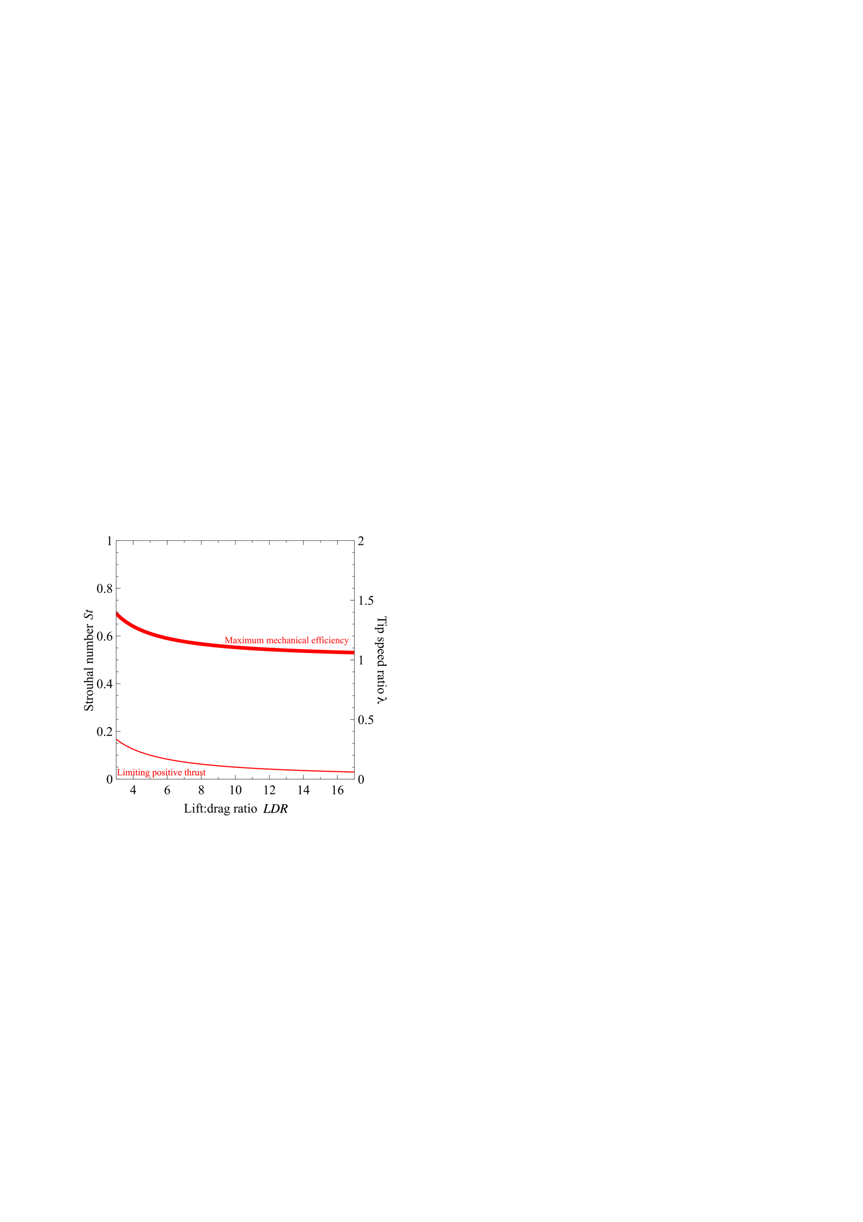

Slide 10
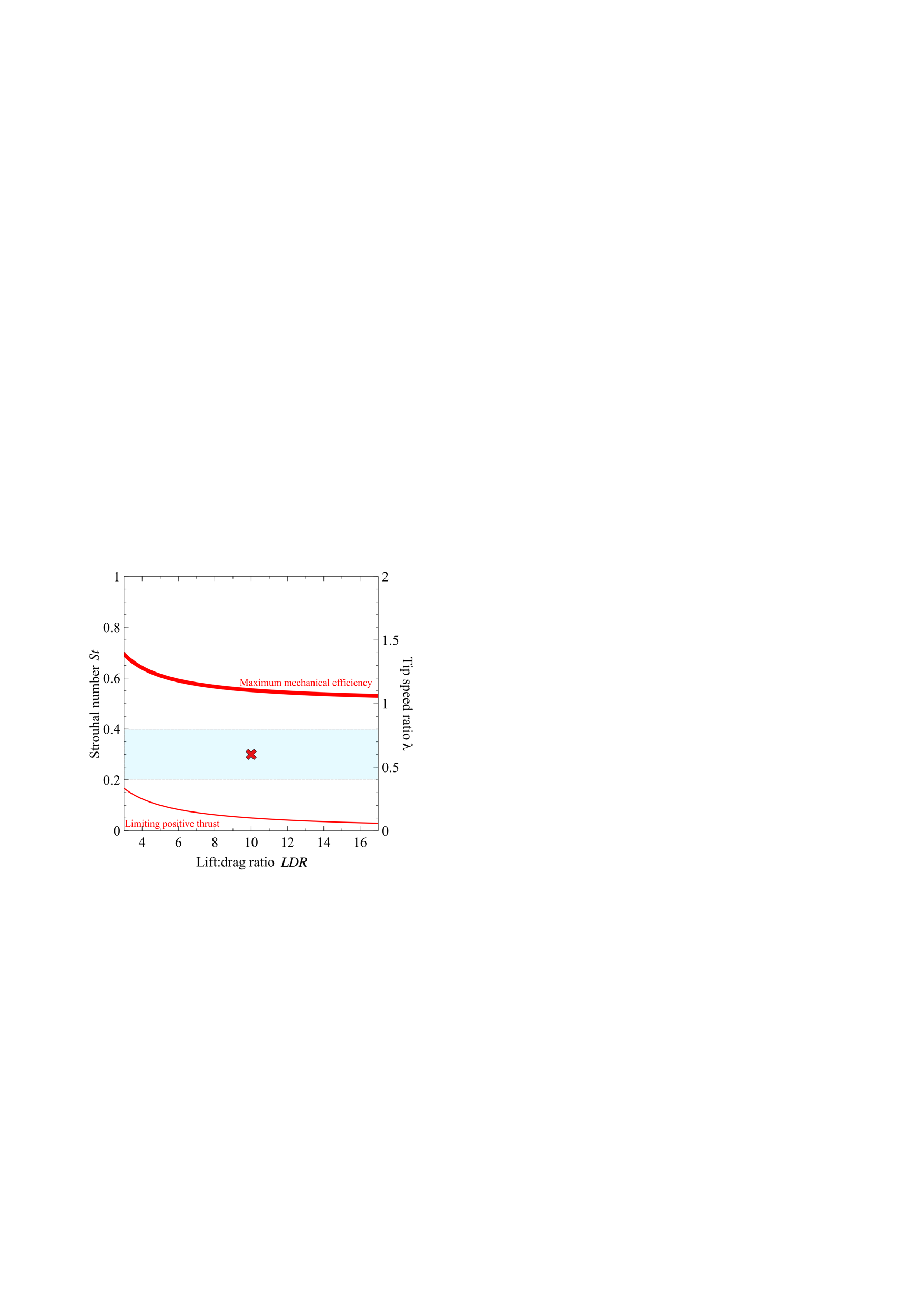

Slide 11
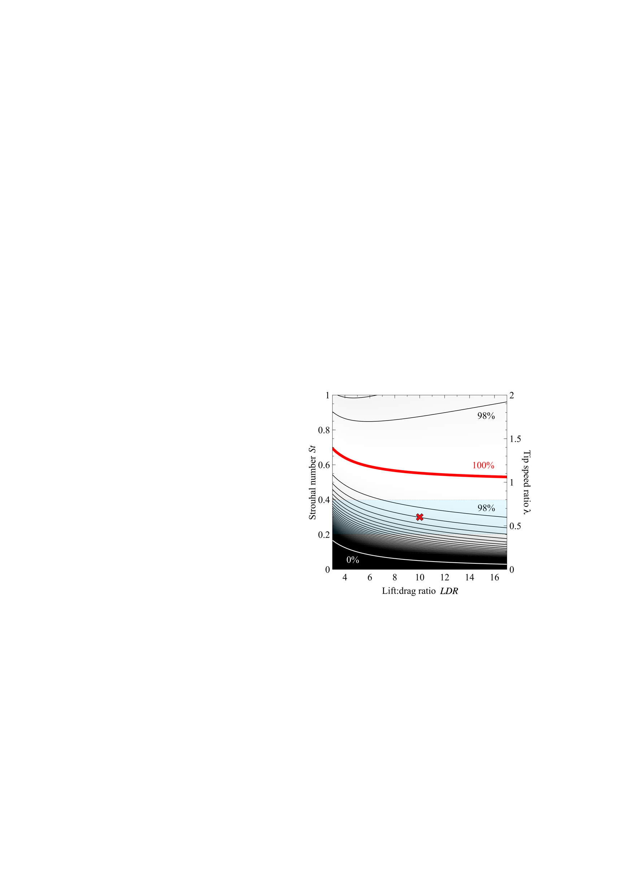

Slide 12
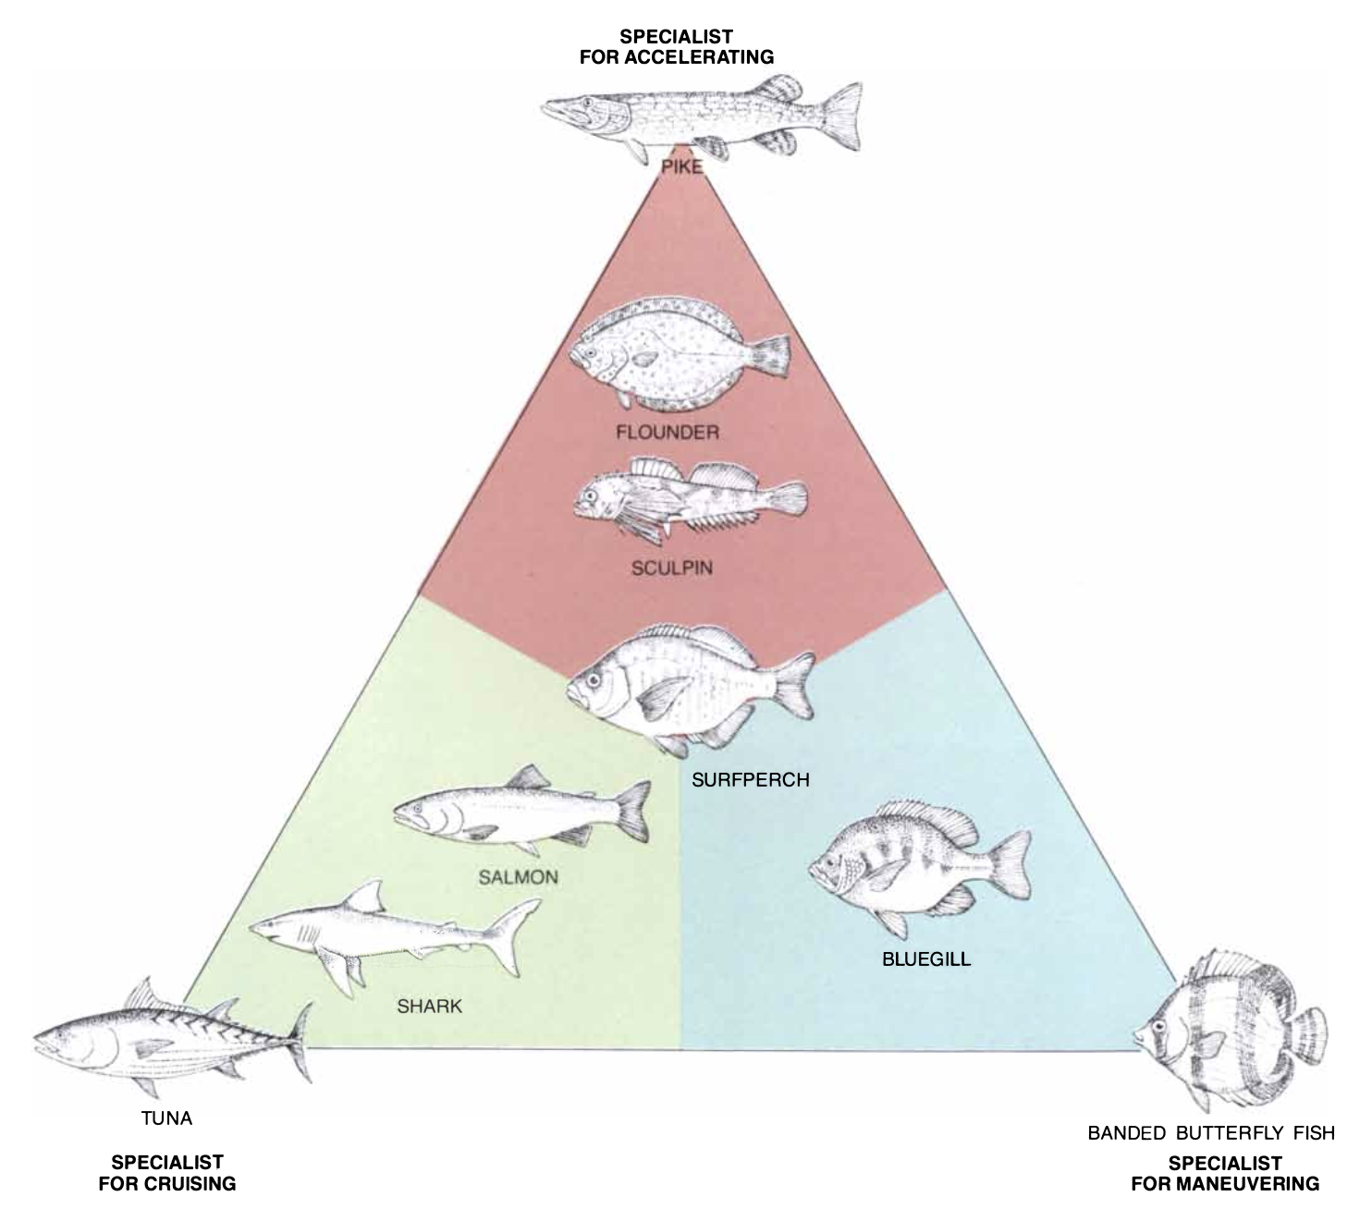
Webb, 1984
[Kara Feilich]

Slide 13
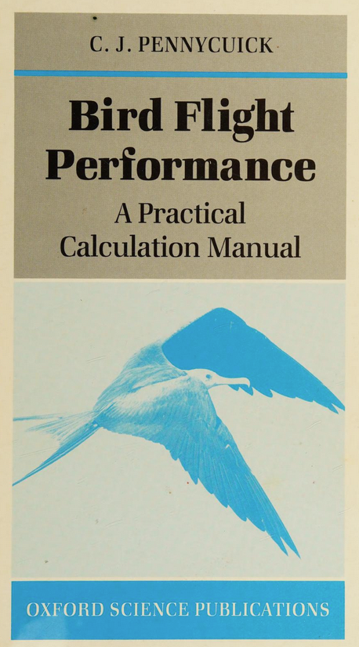
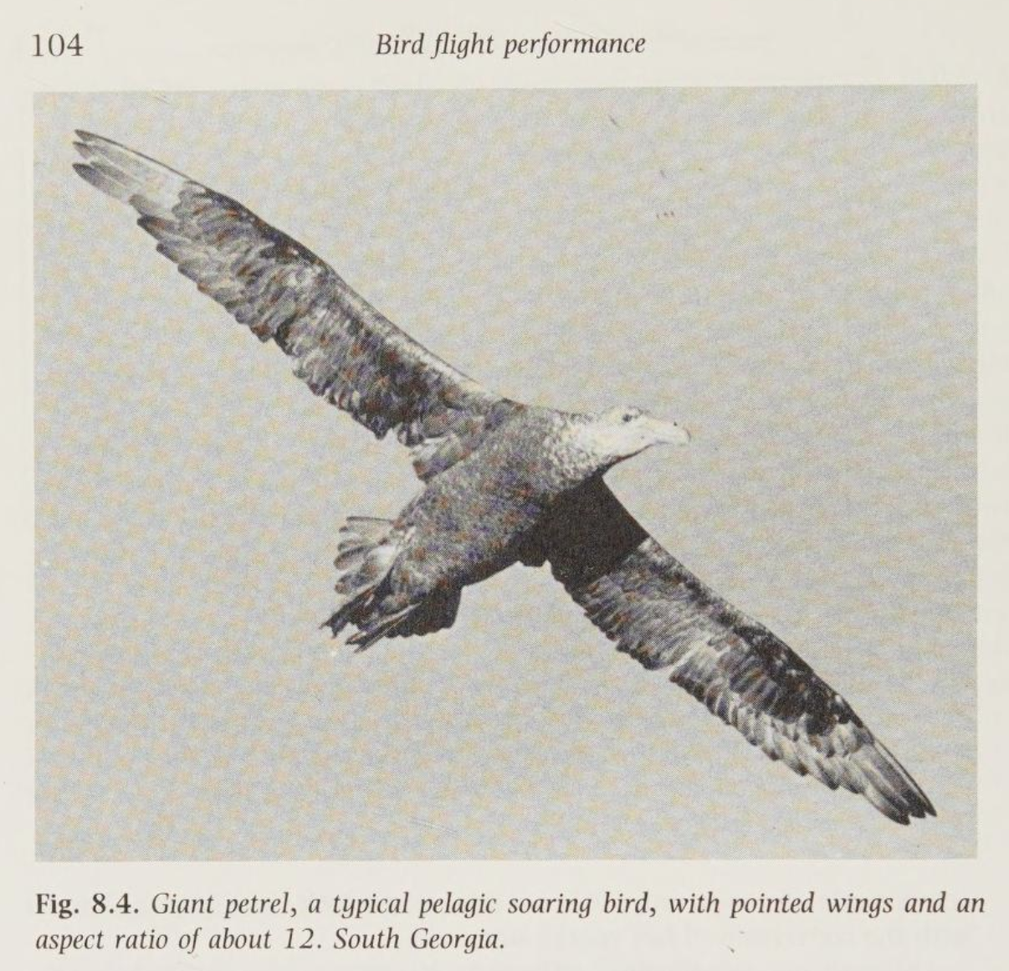
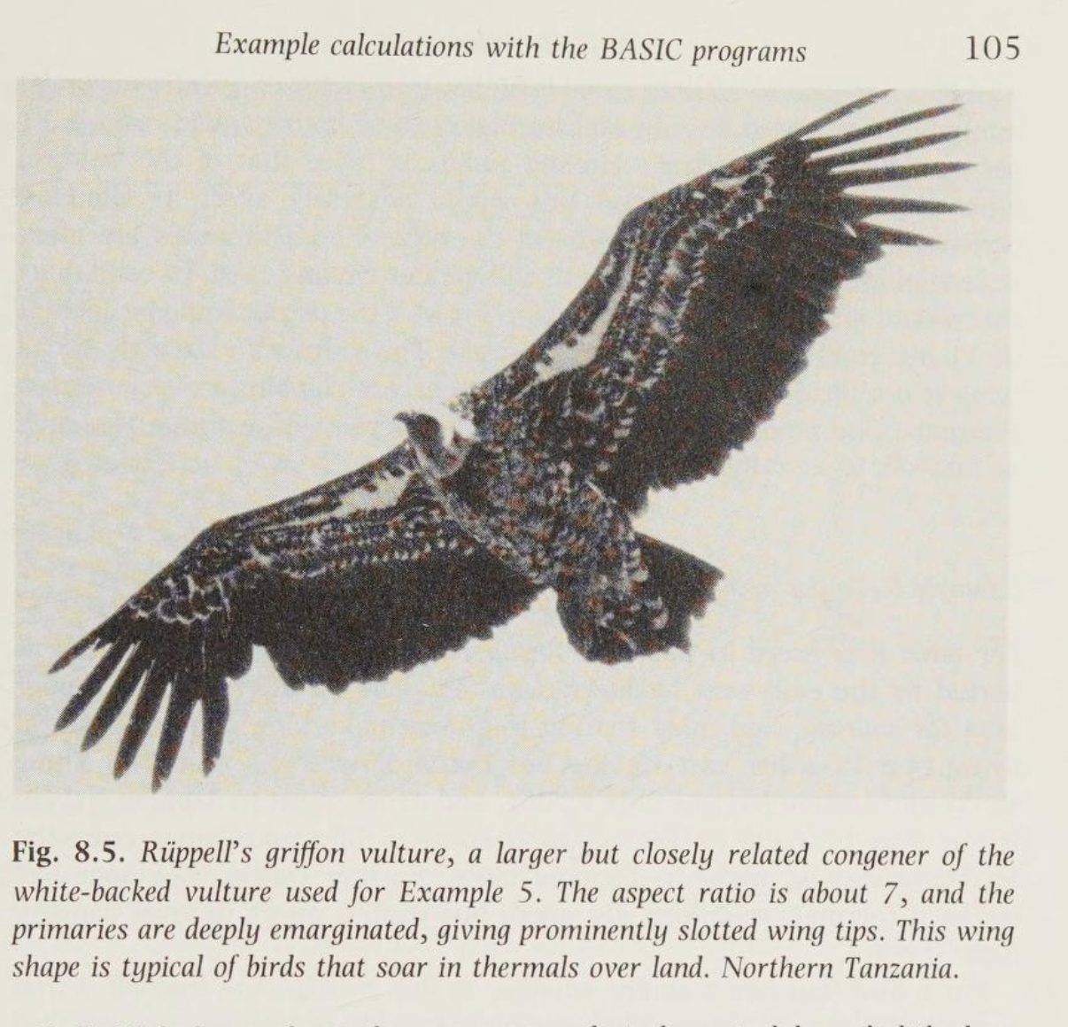
Pennycuick, 1989

Slide 14
“The vulture’s extremely broad wing is not ideal for any aspect of soaring except climbing in very narrow thermals. One probably should look at other aspects of performance, such as take-off, to account for it”.
Pennycuick, 1989

Slide 15

Going faster…

Slide 16

Getting smaller…

Slide 17
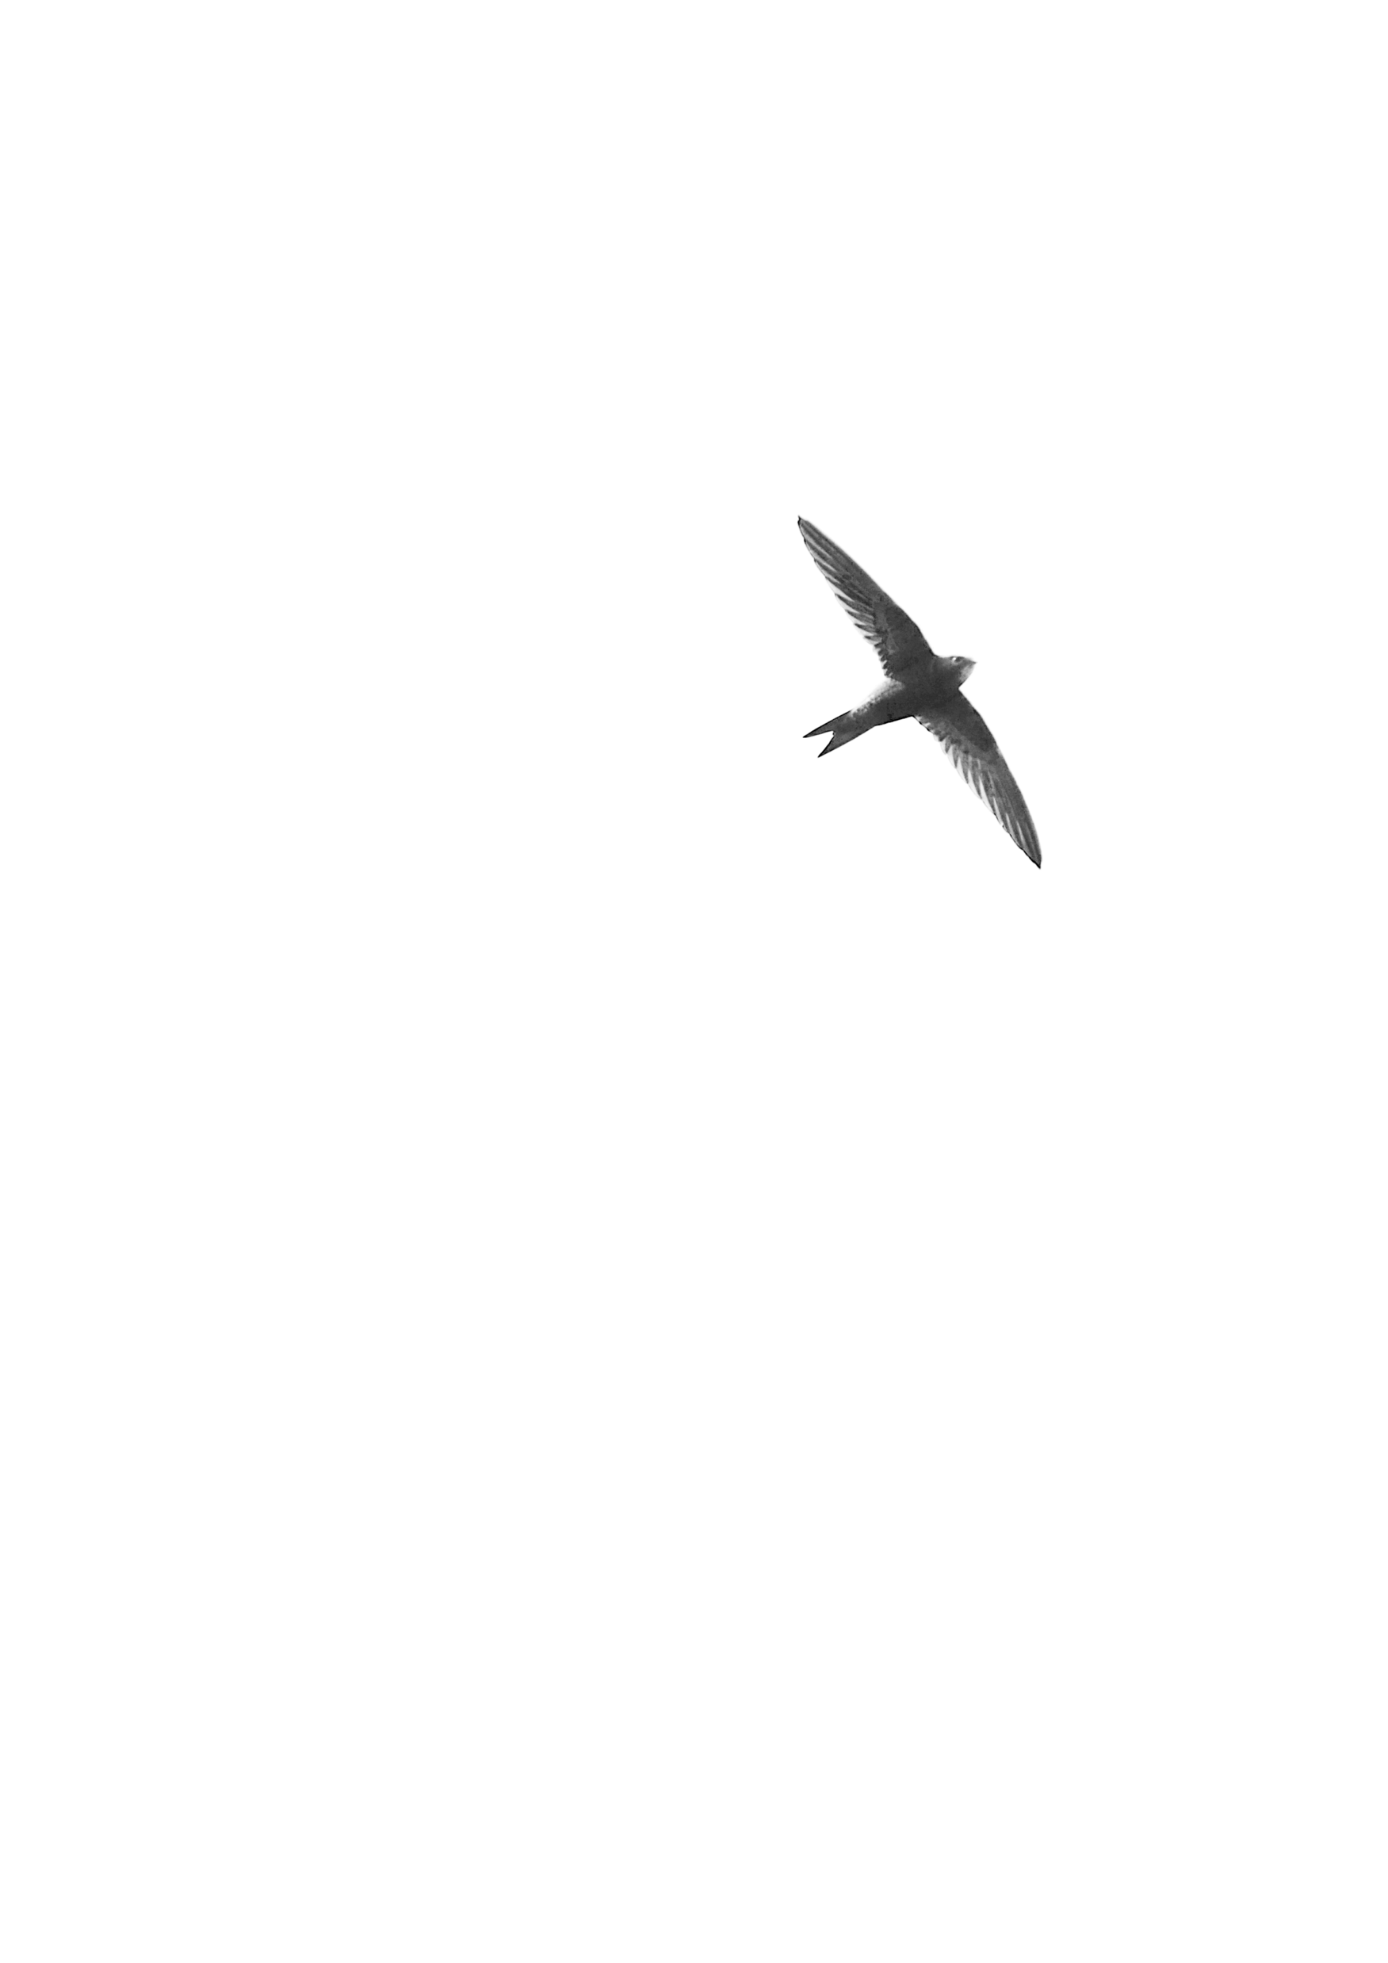
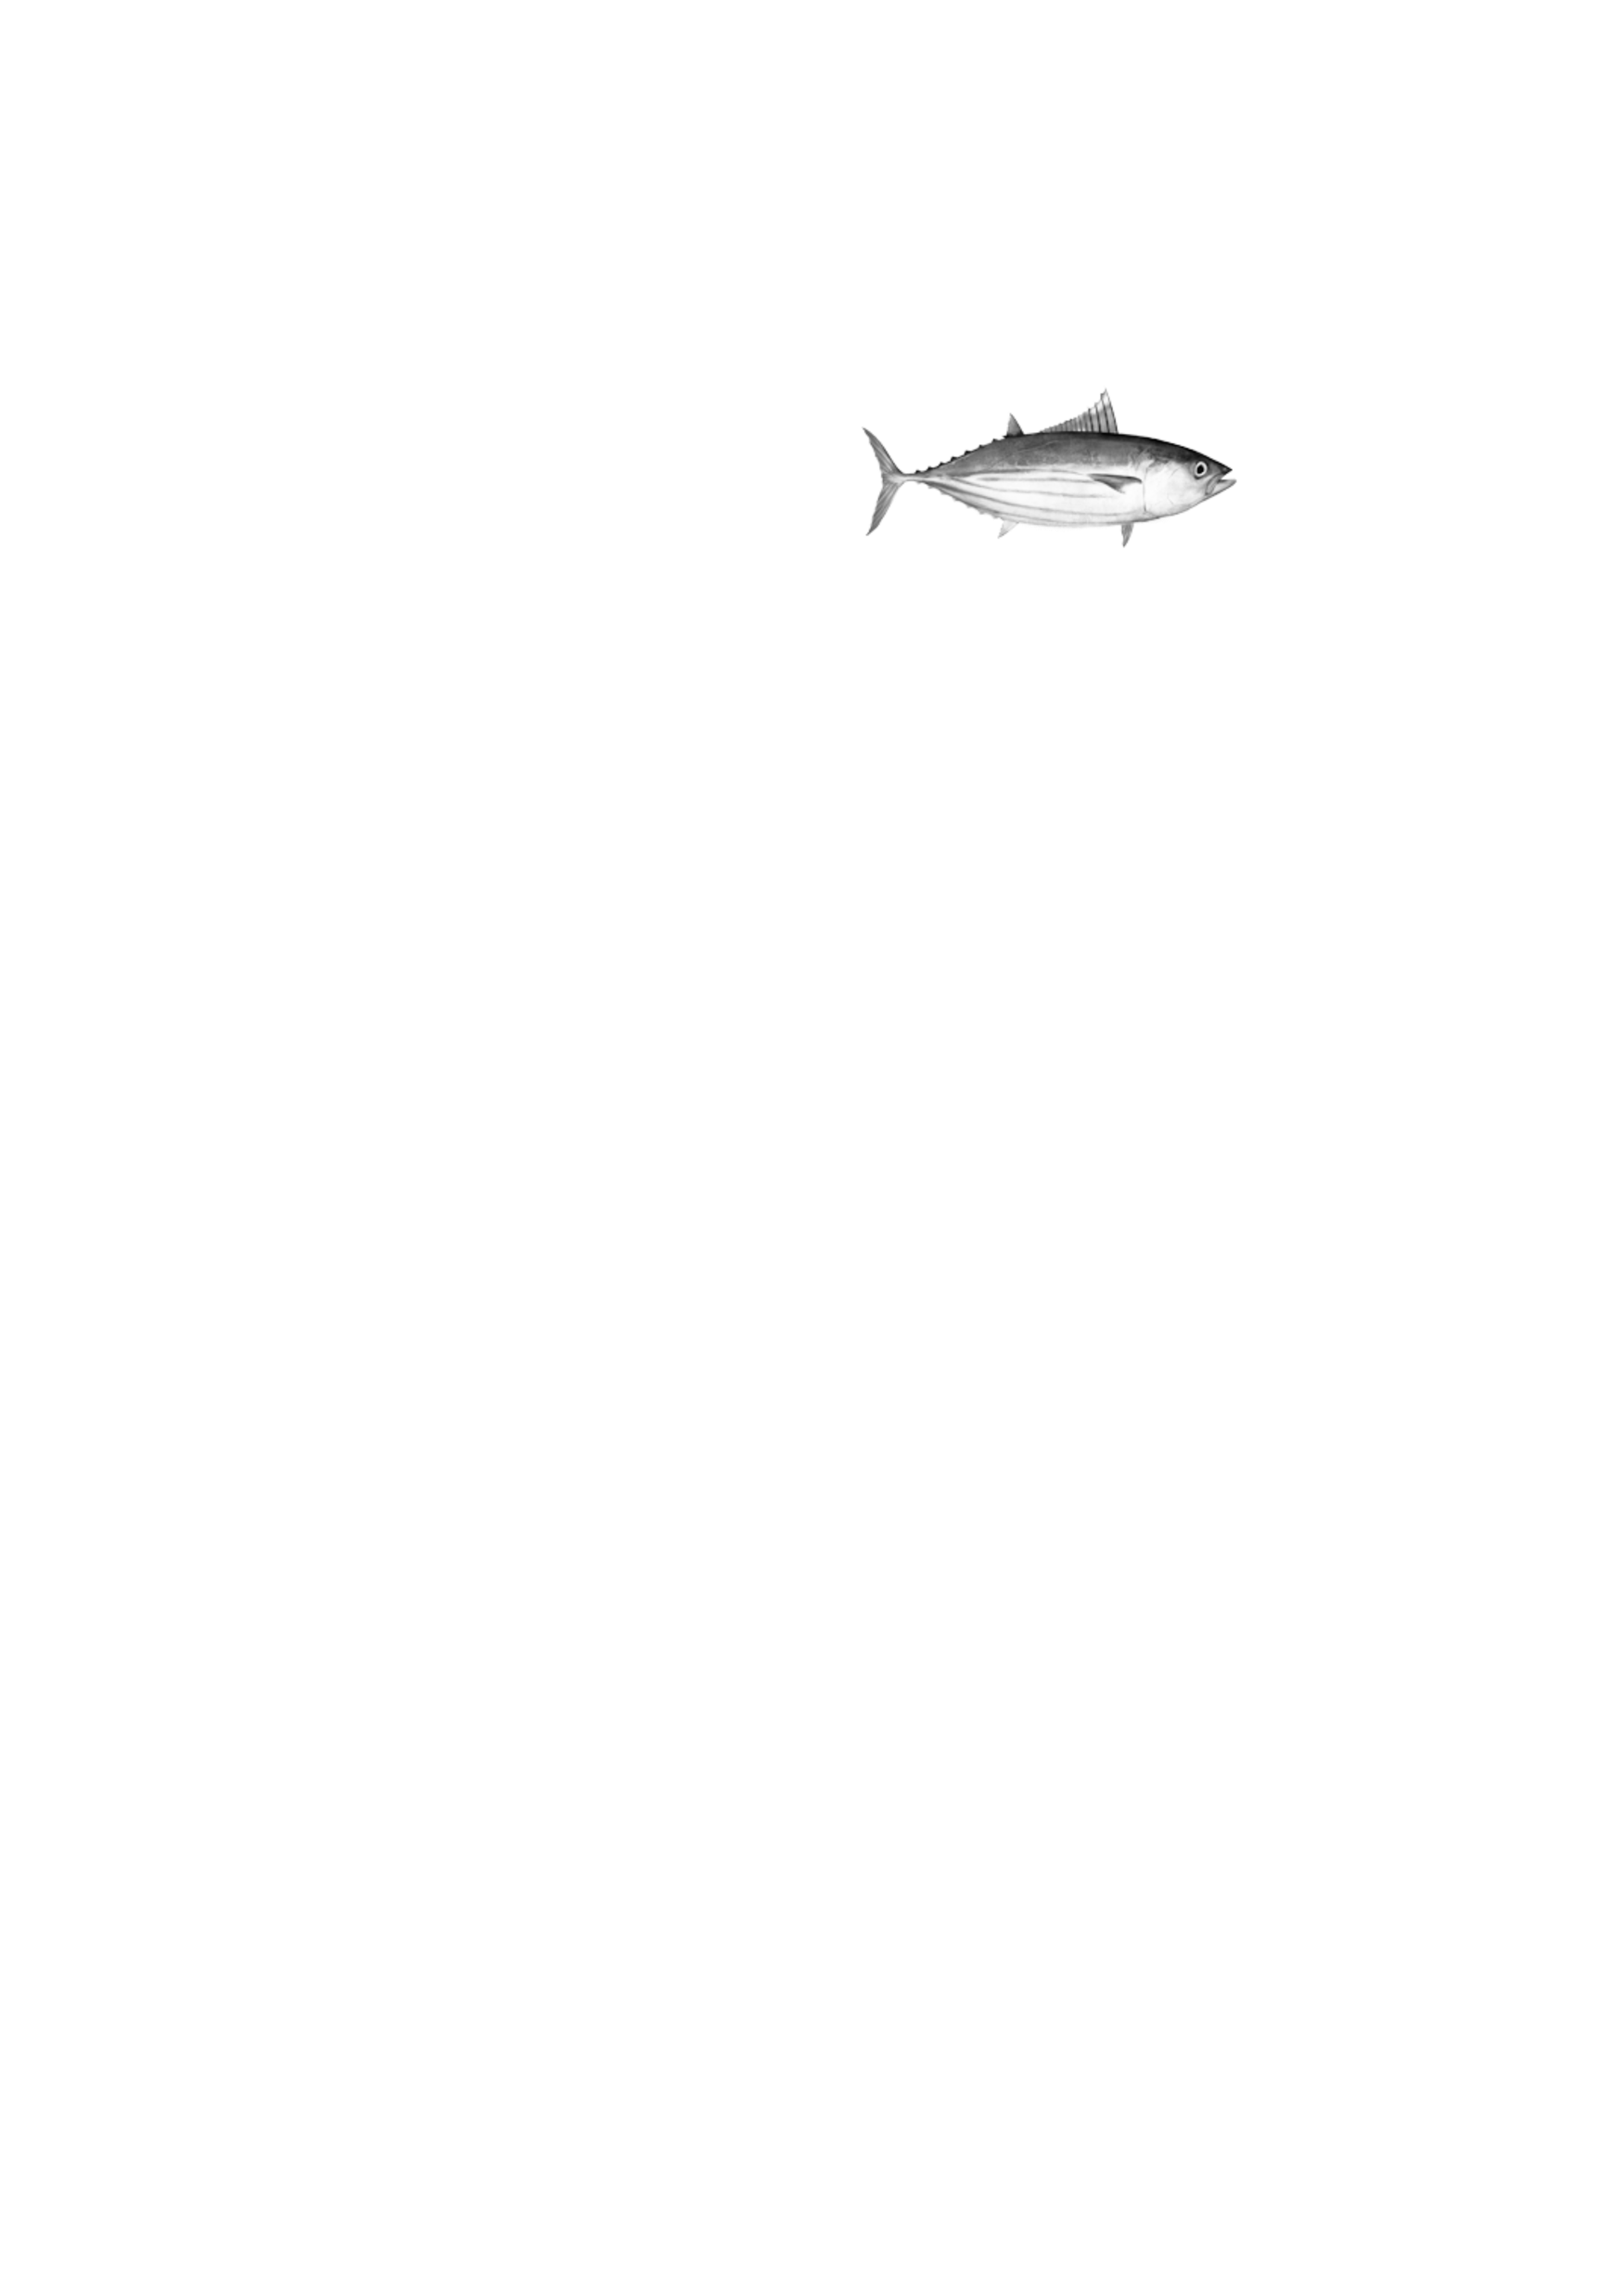
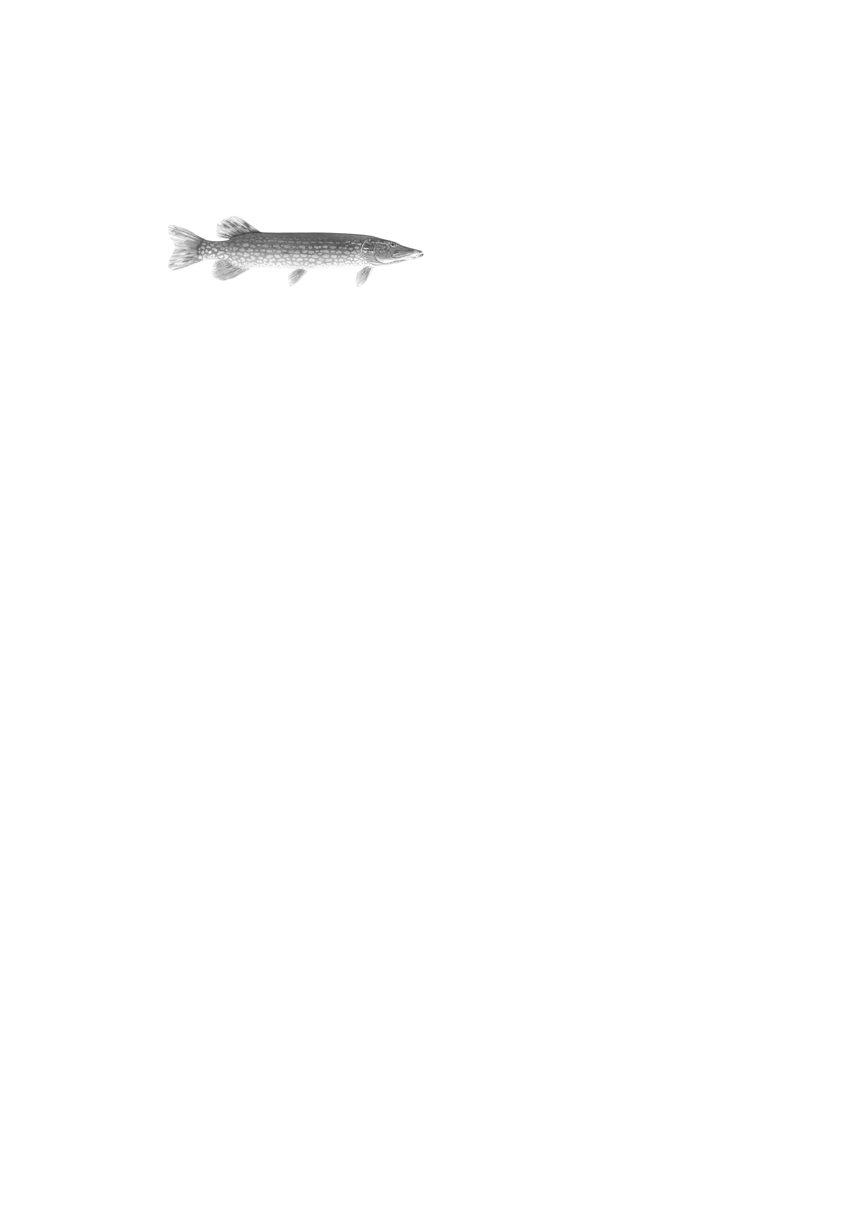
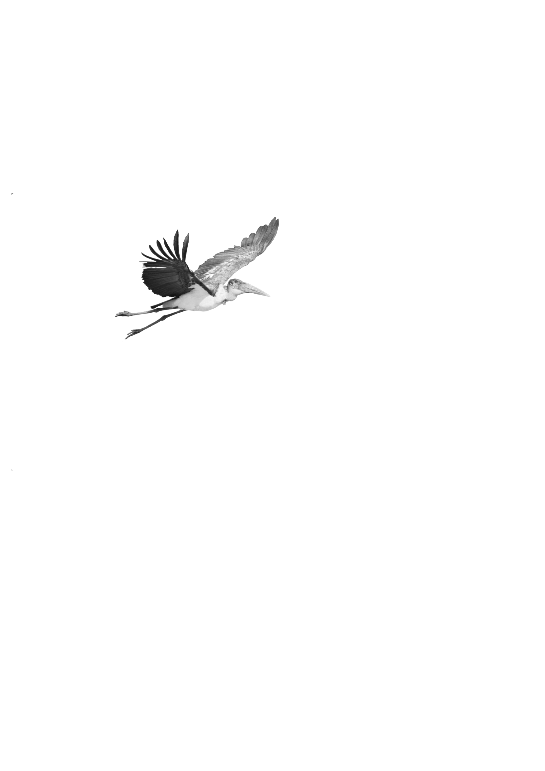

Slide 18

Going slower…

Slide 19
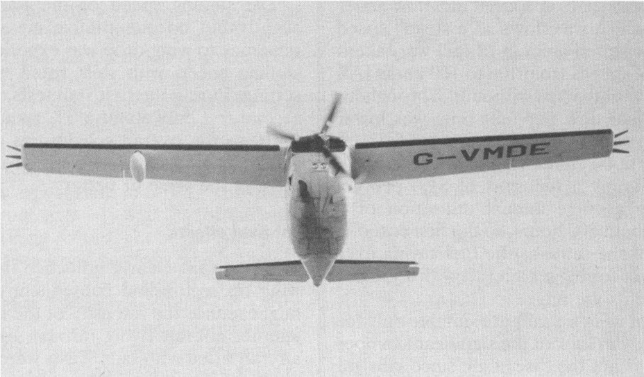
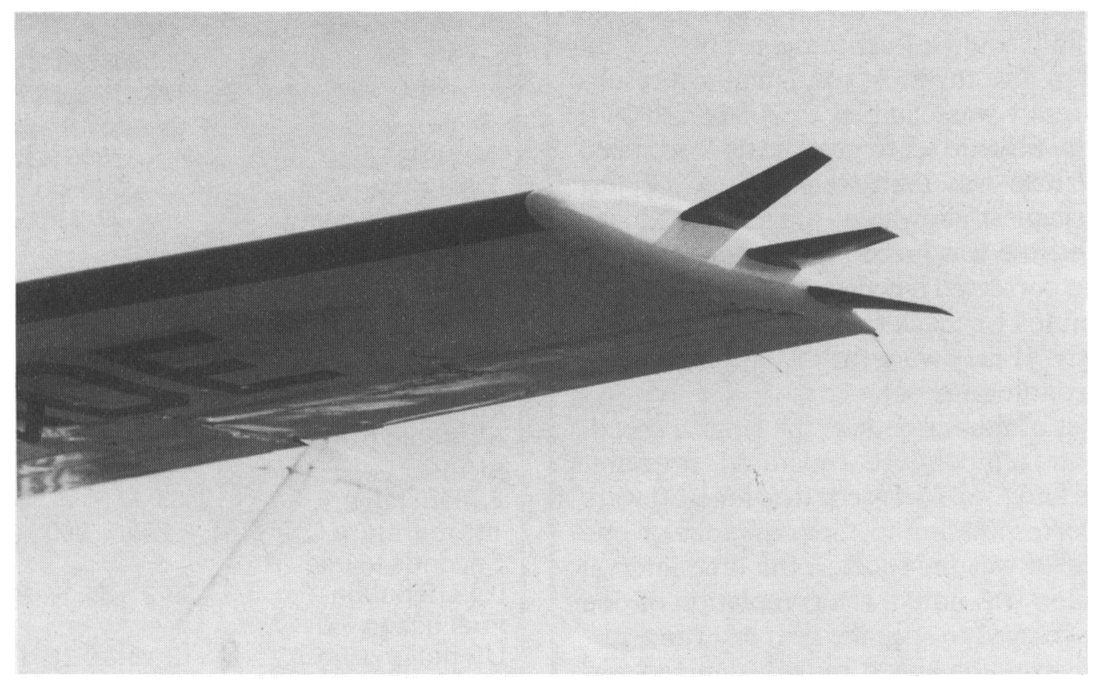
Spillman, J.J. and McVitie, A.M. (1984). Wing tip sails which give lower drag at all normal flight speeds. The aeronautical Journal of the RAes, 88, 362-369.

Slide 20
‘It is with regret that the author has to admit that the work described above had proceeded quite a long way before it was realized that most birds used their primary feathers as wing tip sails.’
Spillman, J.J. (1987). Wing tip sails; progress to date and future developments. Aeronautical Journal. 91, 445-453

Slide 21
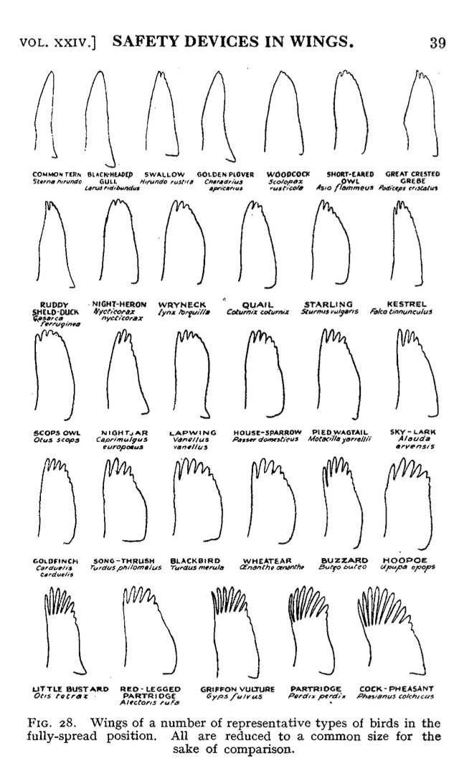
Graham, 1930

Slide 22

Getting bigger…

Slide 23
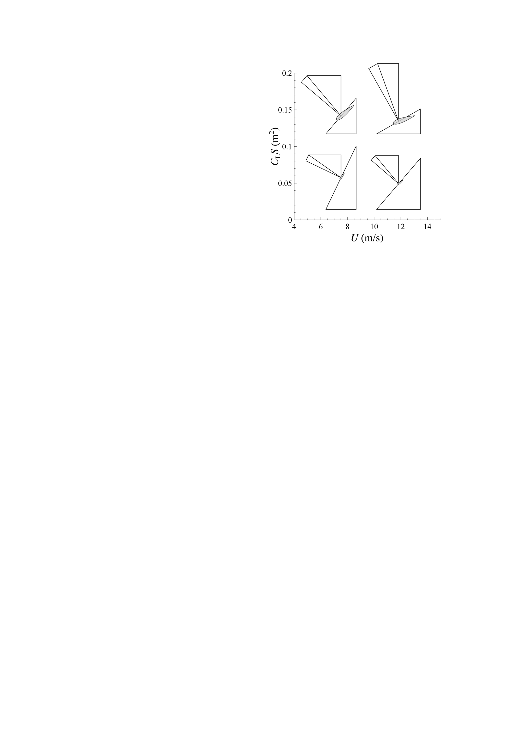
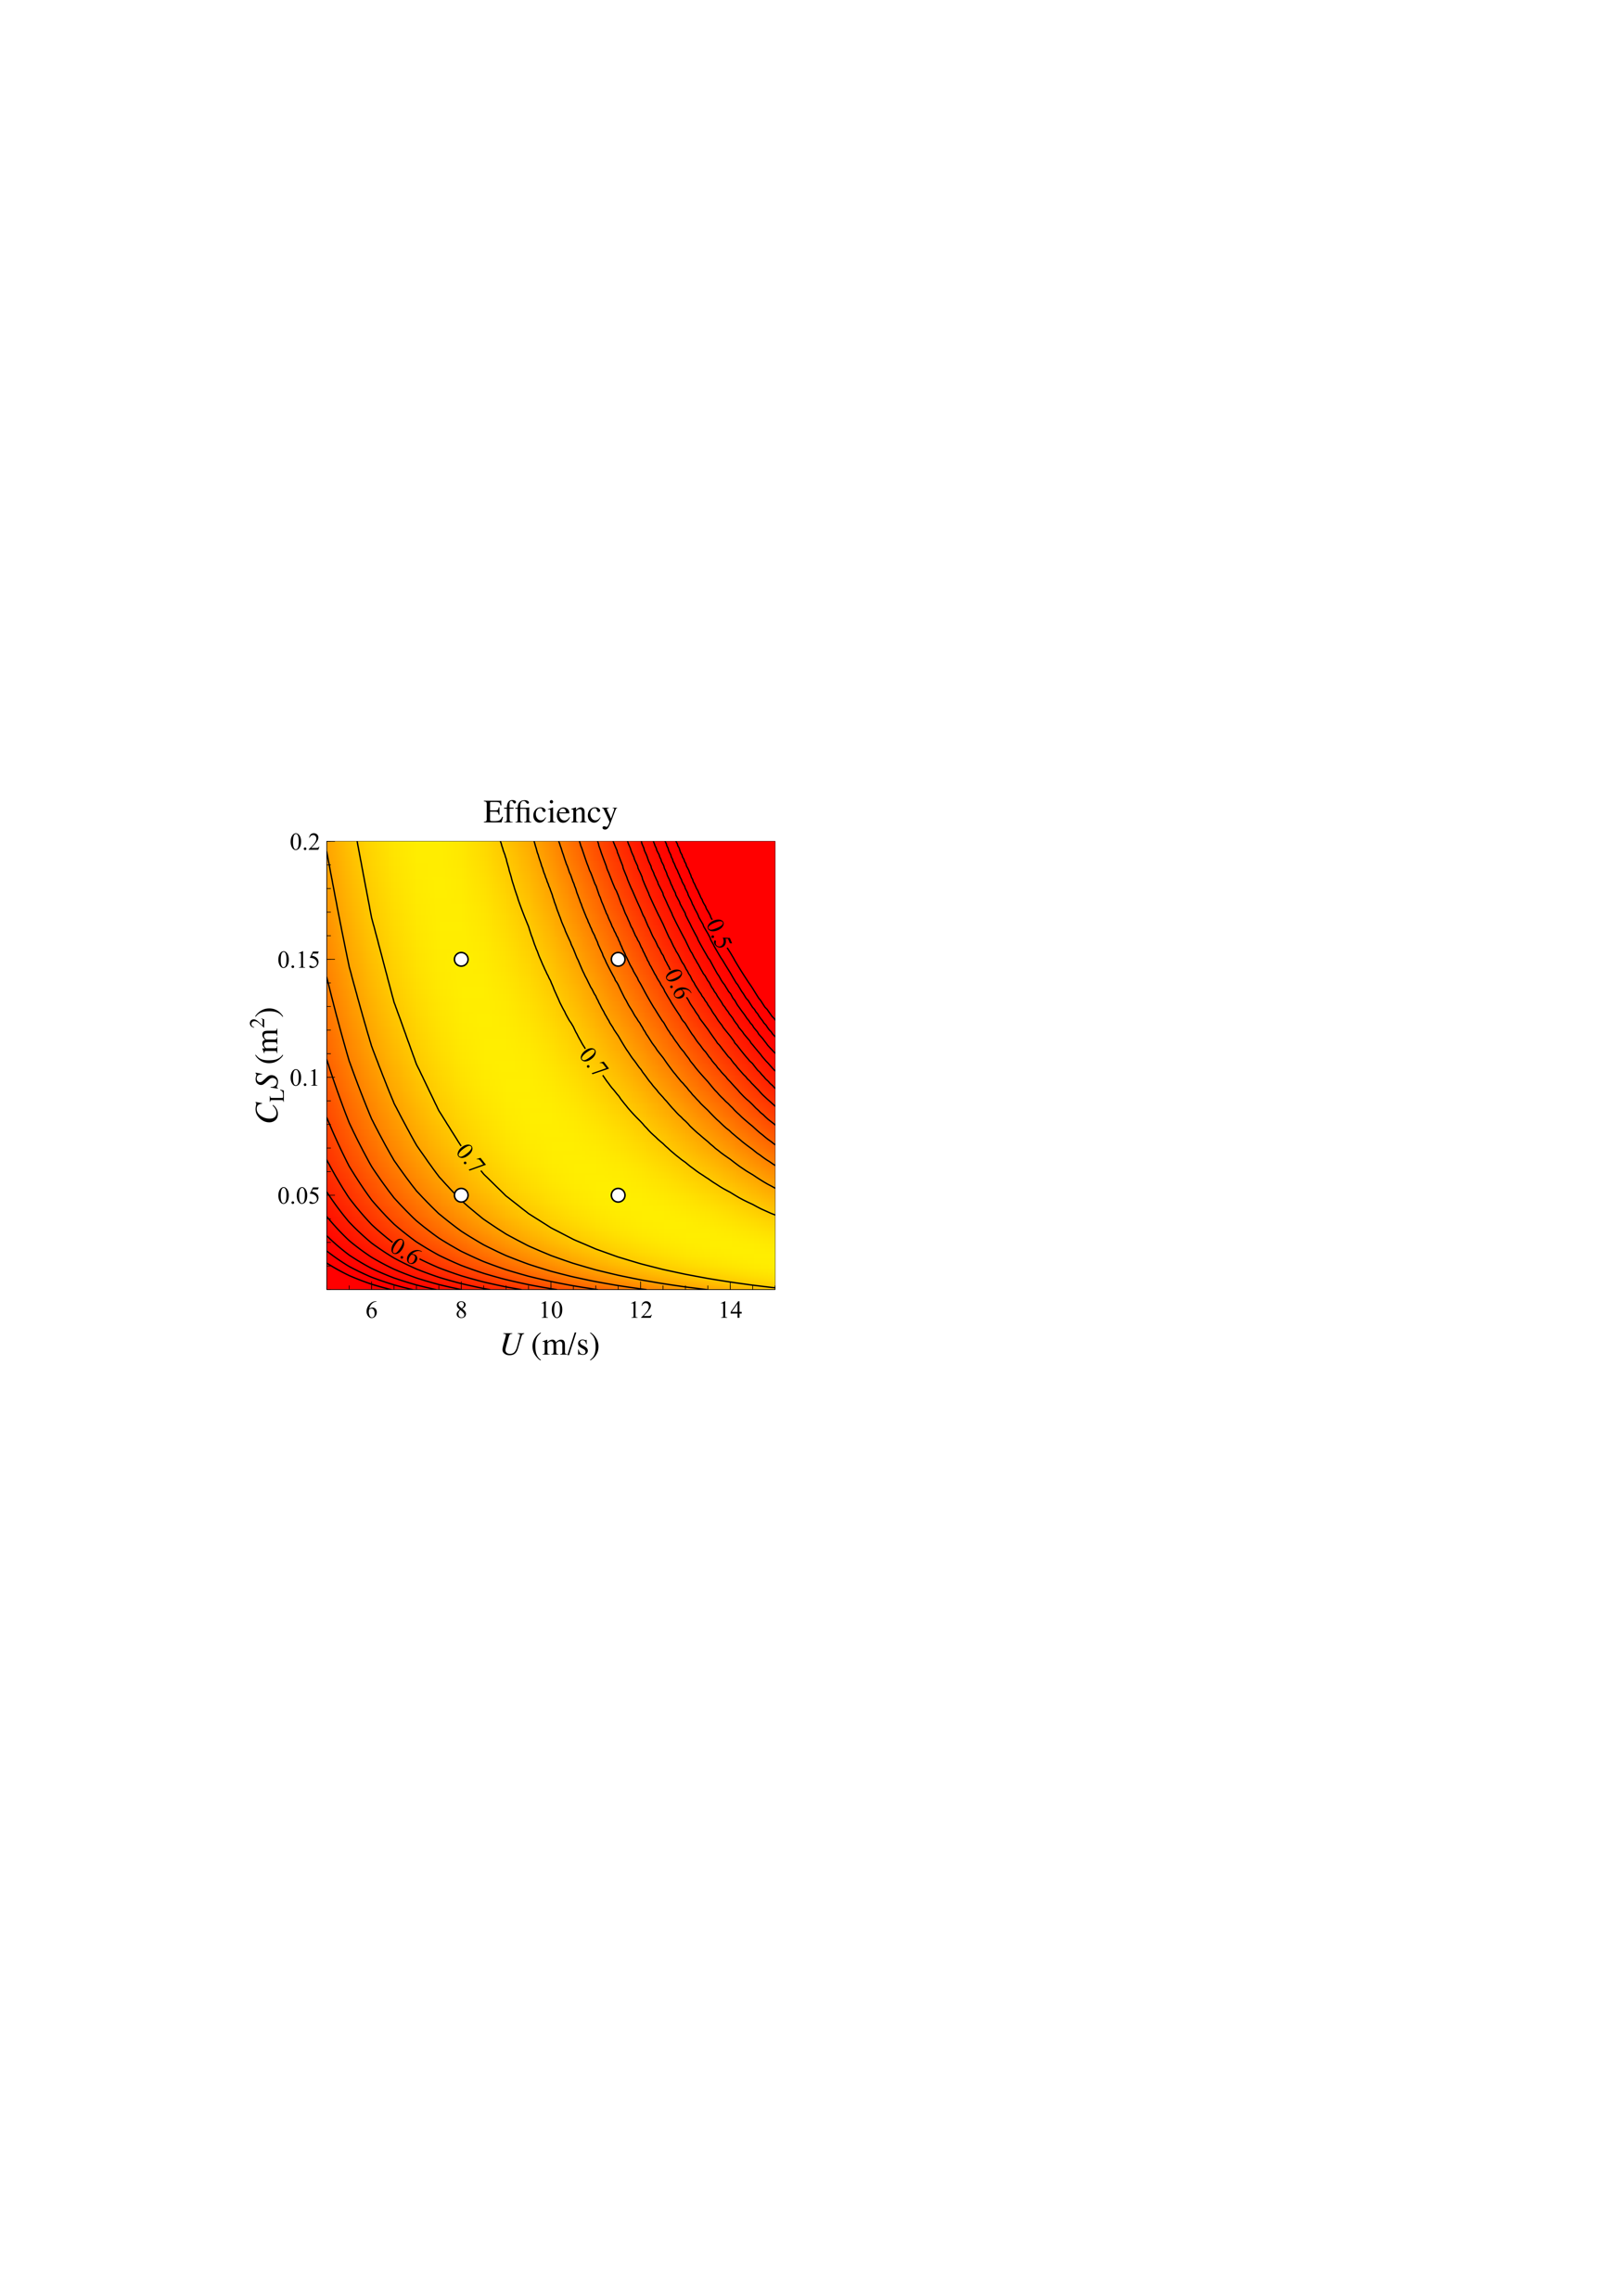
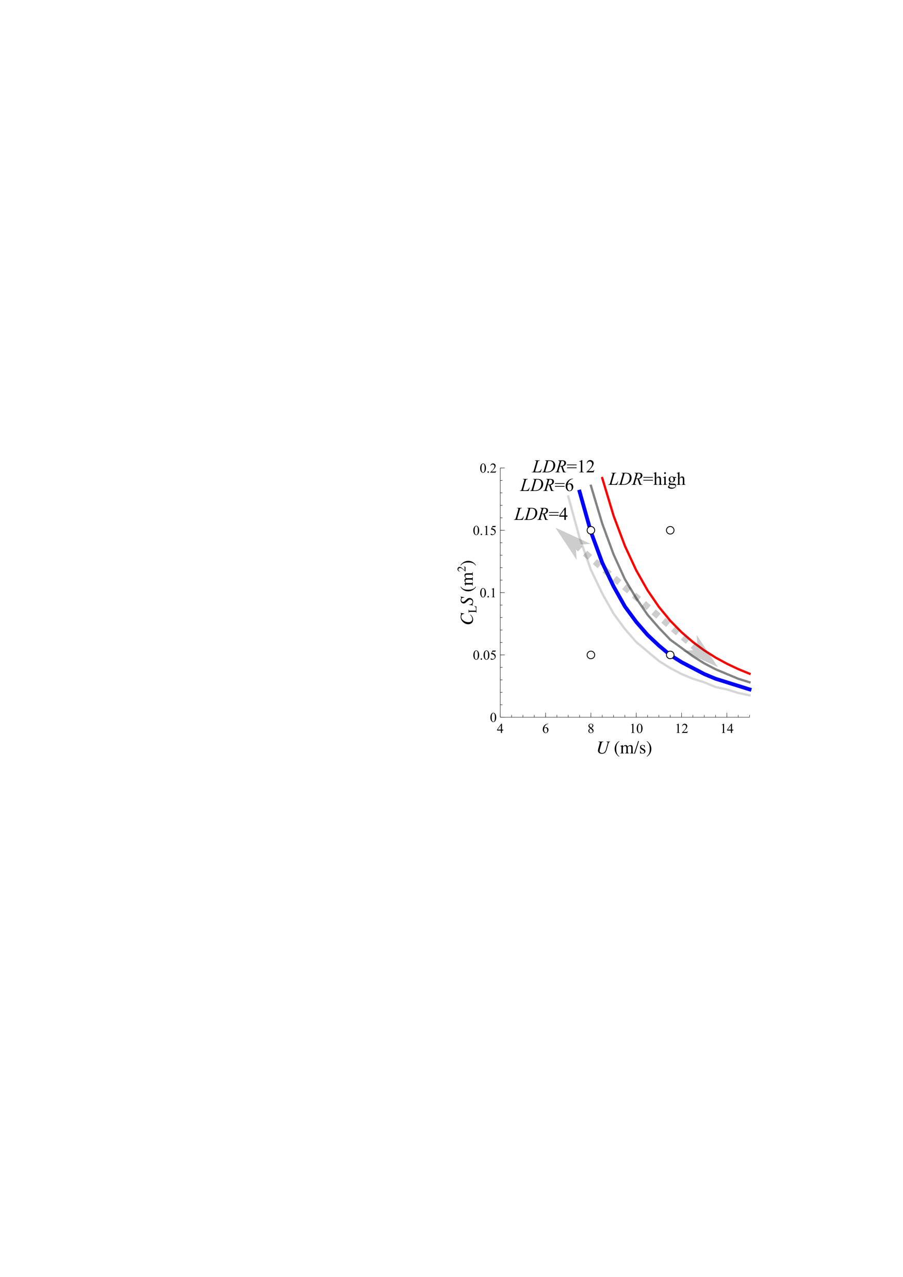

Slide 25
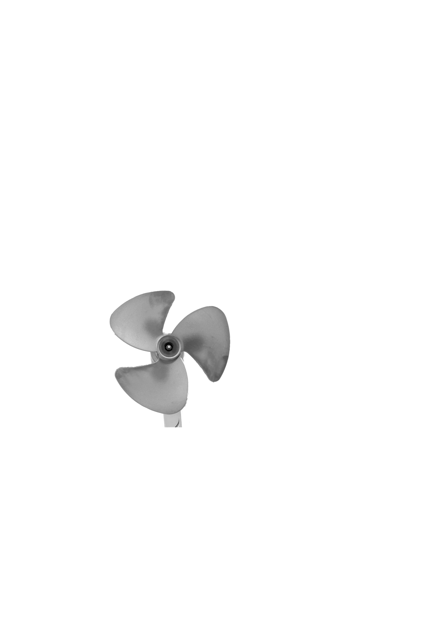
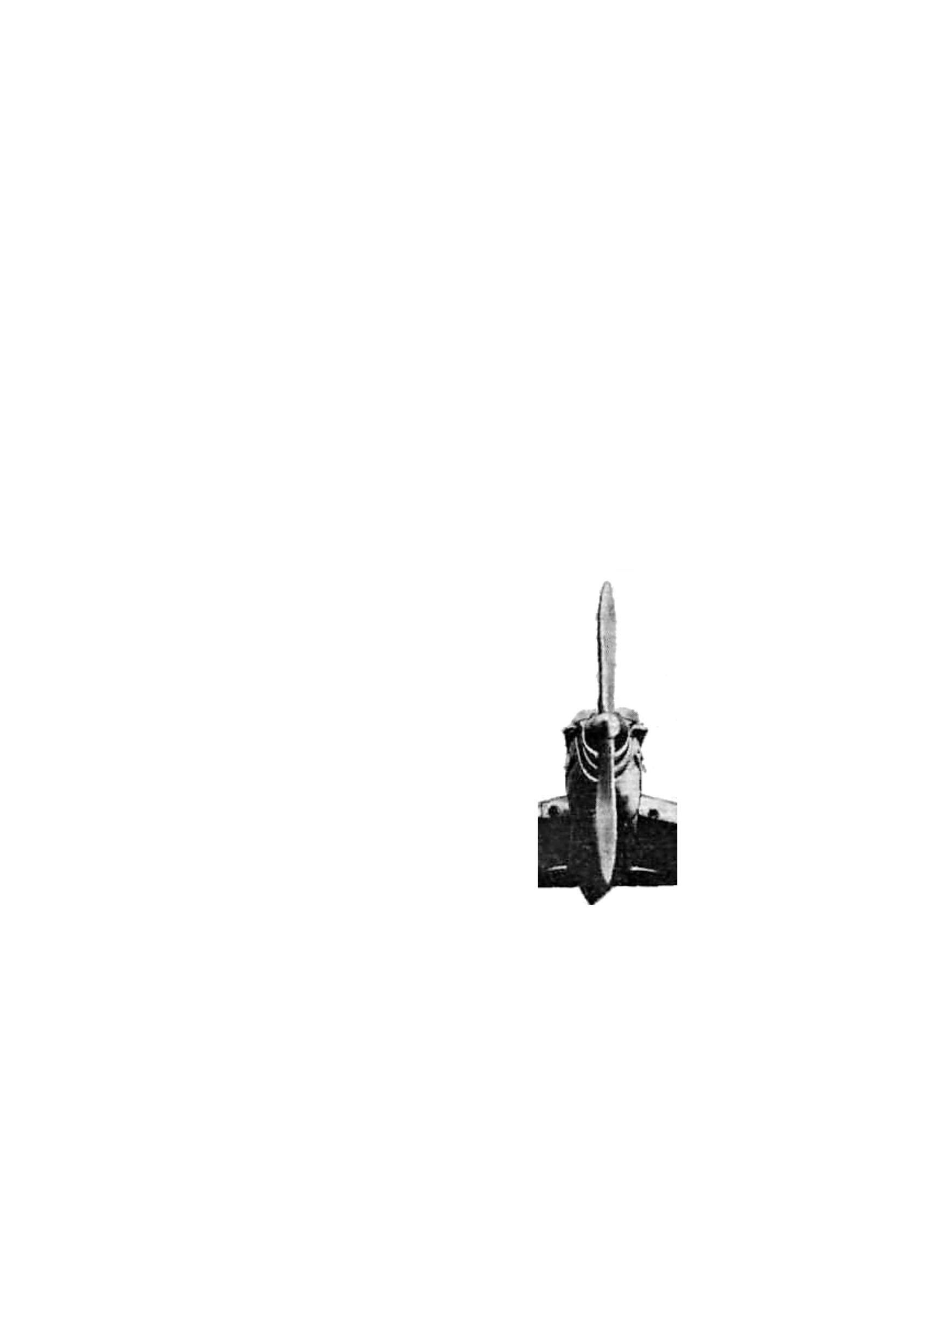

Slide 26
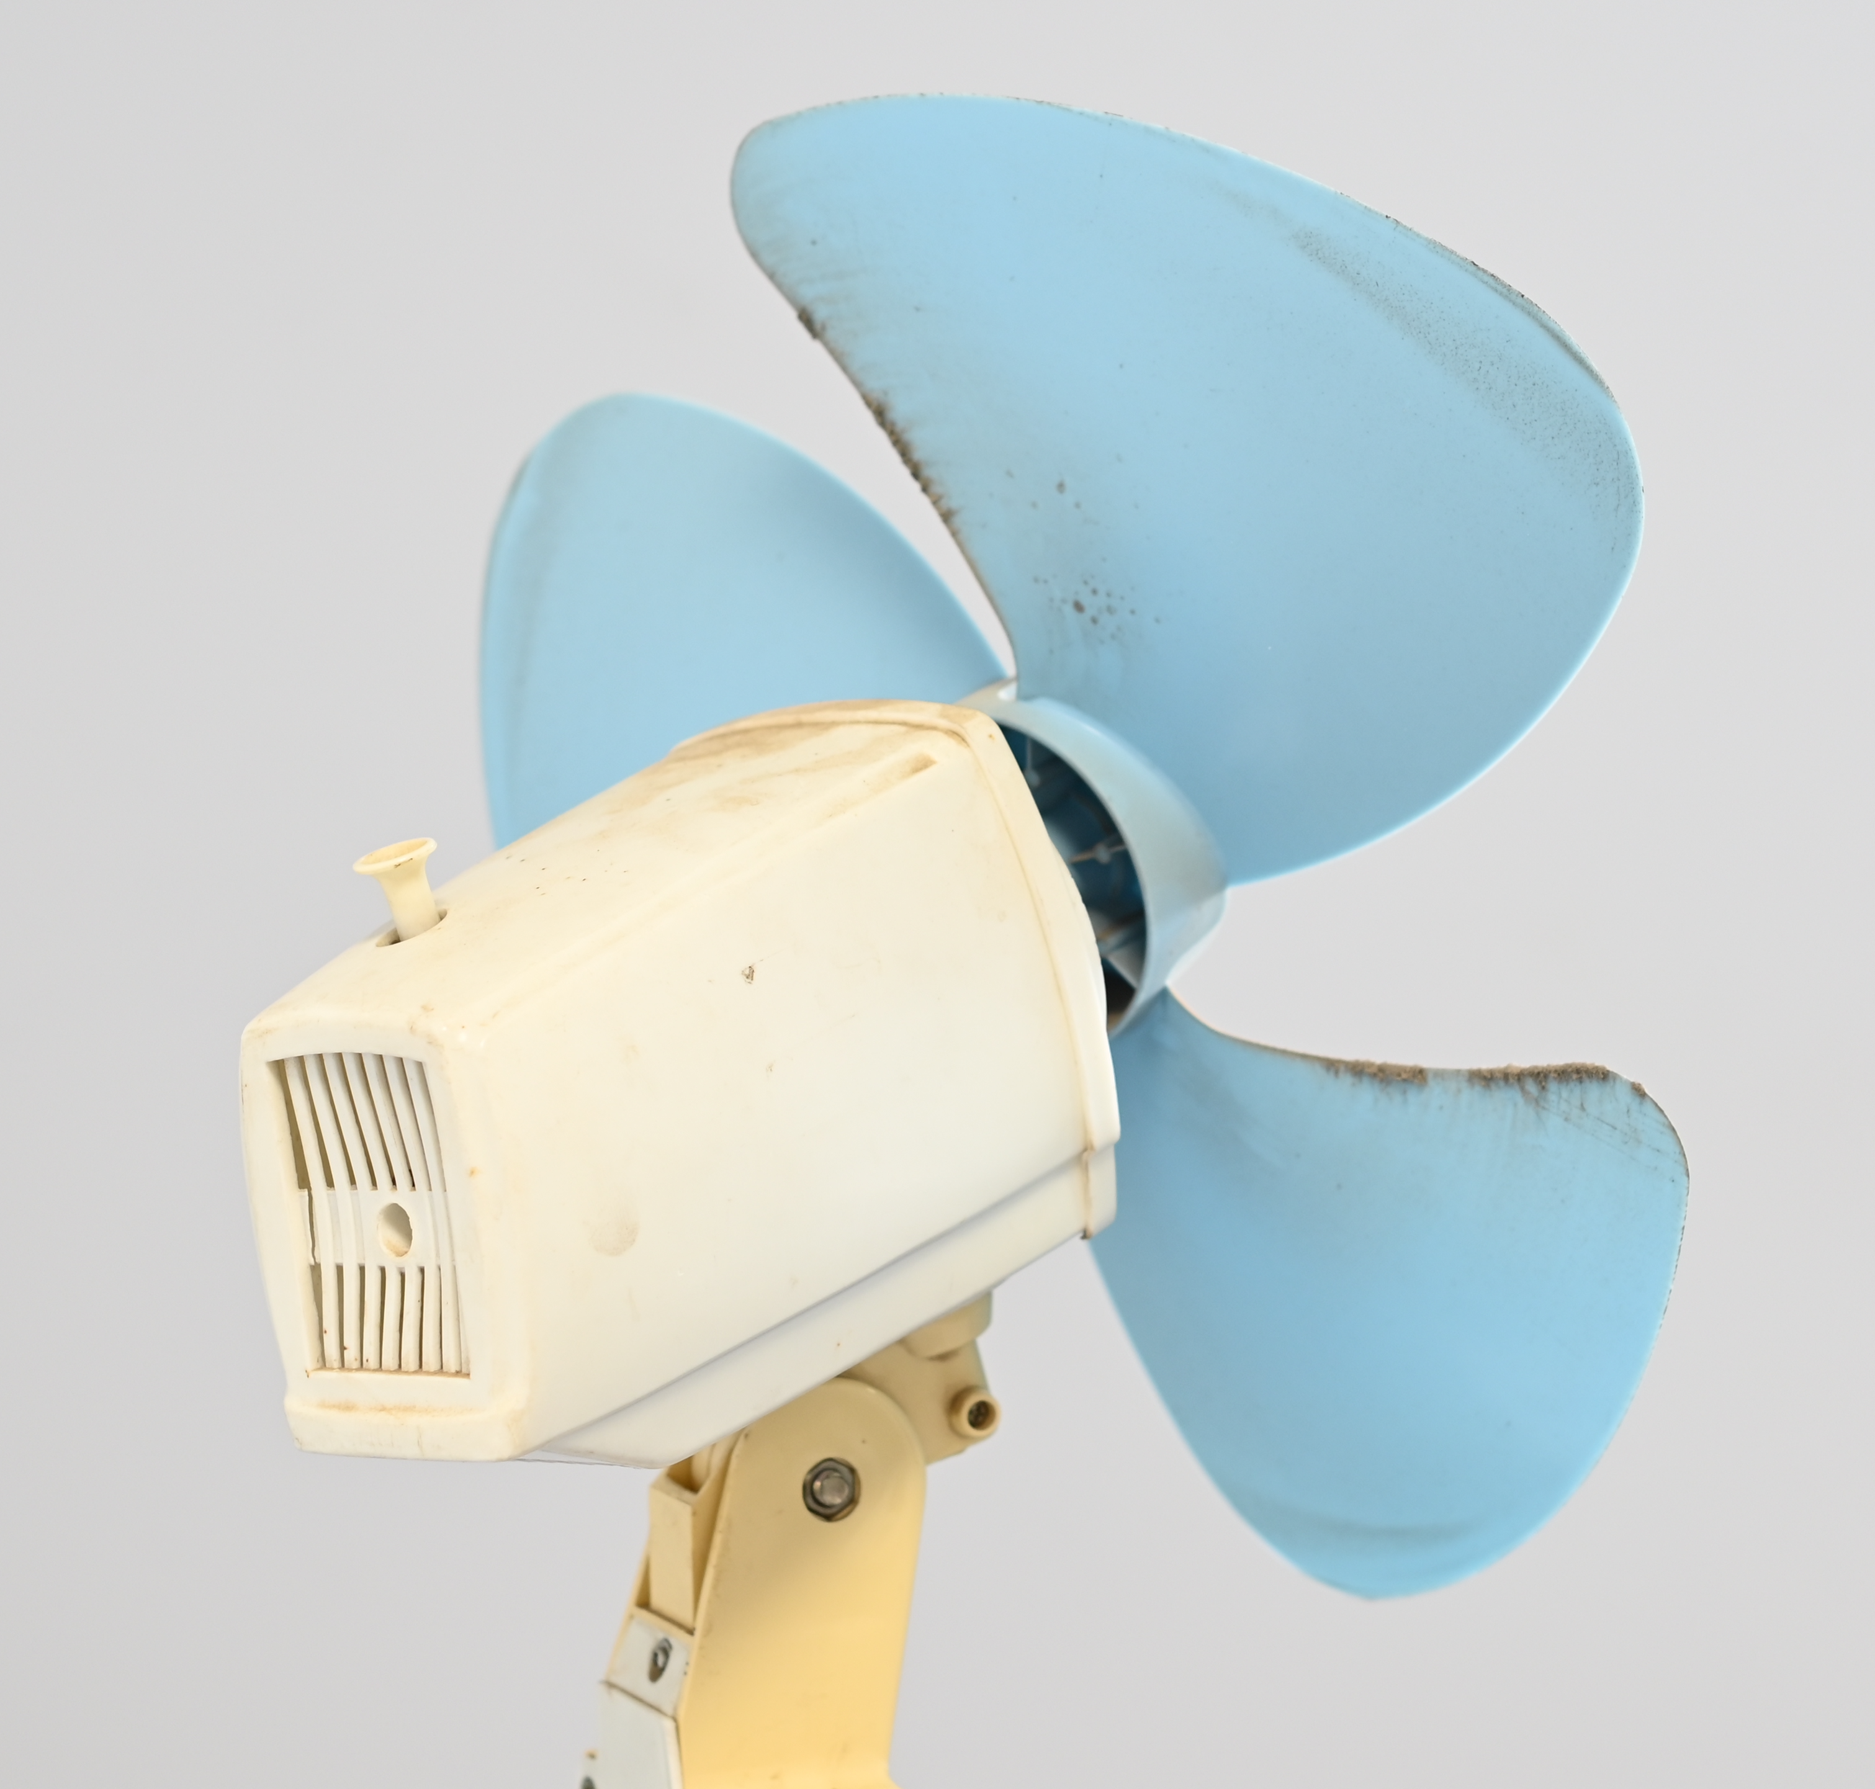

Slide 27
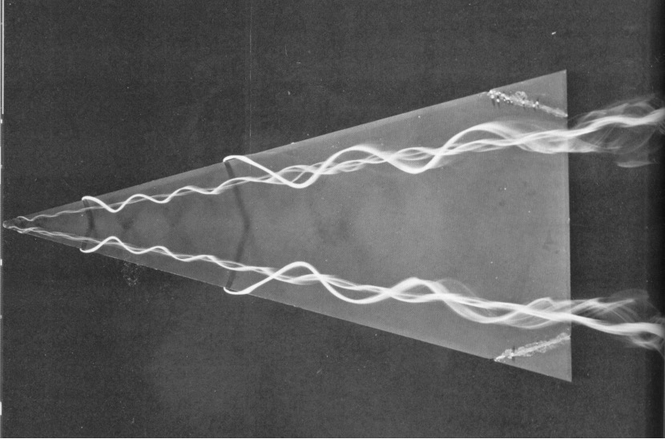
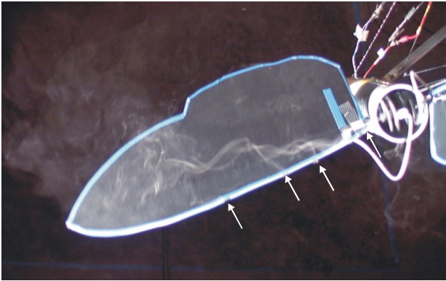
Werlé, 1963
Usherwood and Ellington, 2002

Slide 29
Propeller principles:
Strouhal number and the pike-tuna, vulture-swift spectrum
Usherwood, J.R. (2025). Limiting and optimal Strouhal numbers or tip speed ratios for cruising propulsion by fins, flukes, wings and propellers. J. R Soc. Interface.
Usherwood, J.R. (in press). Propeller efficiency and the spectrum of propulsor form with speed, from pike to tuna, vulture to swift. J. R Soc. Interface.
Jim Usherwood. Structure and Motion Lab., The Royal Veterinary College
JimUsherwoodResearch.com/wings-and-fins

