Slide 1



Legs as linkages to legs as machines
Jim Usherwood. Structure and Motion Lab., The Royal Veterinary College
JimUsherwoodResearch.com
Notes:
Title page.

Slide 2
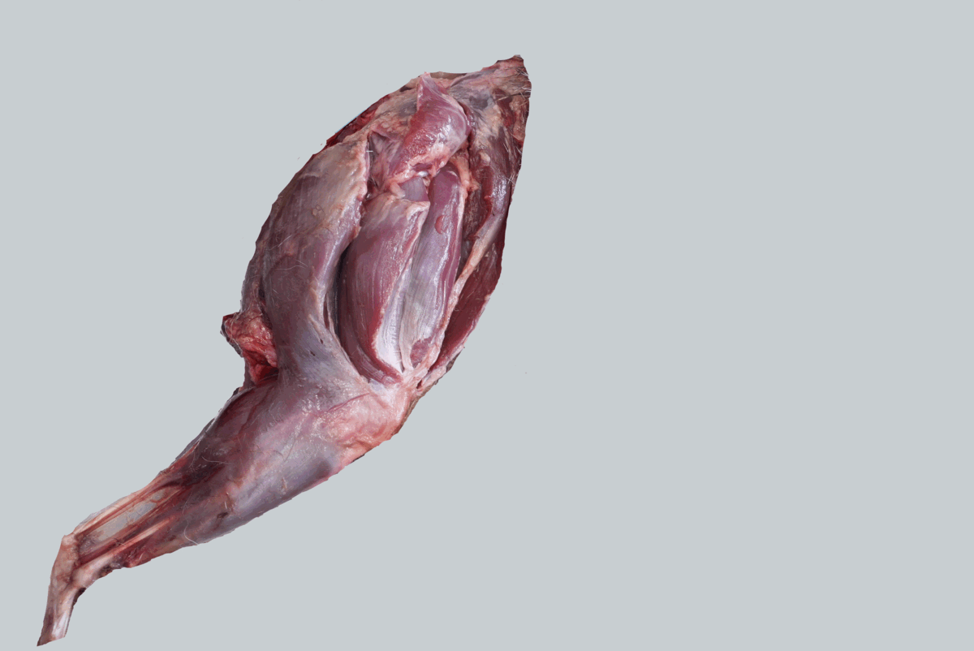
Notes:
Many muscles insert to the patella. This is a partly dissected hindlimb of a fox.

Slide 3
WHAT ARE LEGS ‘FOR’?
WHAT ARE MUSCLES IN LEGS ‘FOR’?
HOW ARE THEY CONTROLLED?
Not just what they ‘do’ (their action); what are they ‘for’ (their function)?
Notes:
The big questions being addressed. Acknowledge distinction between action and function can get fuzzy.

Slide 4
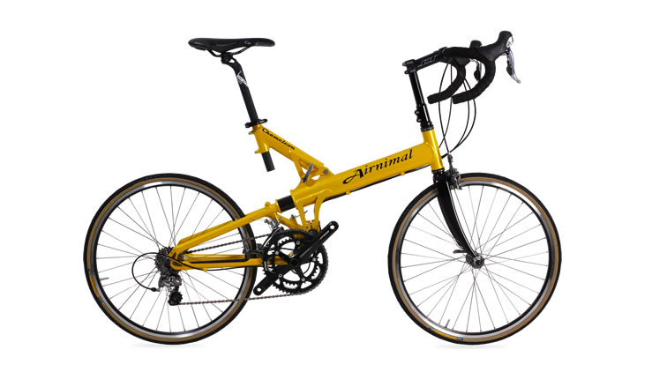
Notes:
Start by thinking about a bicycle as we know ‘why’ the components of a bicycle are helpful – because we designed them. Look for analogies in leg form/function.

Slide 5

Notes:
Note several aspects ‘for’ avoiding mechanical power demand: here, drop handle bars avoid aerodynamic drag. Not considered further.

Slide 6




Notes:
Pneumatic tyres also allow some avoidance of mechanical power demand through elastic recoil. Potential analogy with elastic mechanisms in animal legs (tendons?). But also not the focus here.

Slide 7












Features that reduce
work demand
Notes:
Spokes and wheels function to enable weight support during translation while largely avoiding mechanical work demand.

Slide 8
Bicycle spokes principles
1. Avoid mechanical work demand:
keep force perpendicular to velocity
2. Avoid mechanical work demand from the components:
don’t change length
3. Simple control:
let changes in geometry load and unload spokes
Notes:
Basic principles of how a wheel works, how spokes enable this without mechanical work demand, and how loading of spokes due to changes in geometry

Slide 9
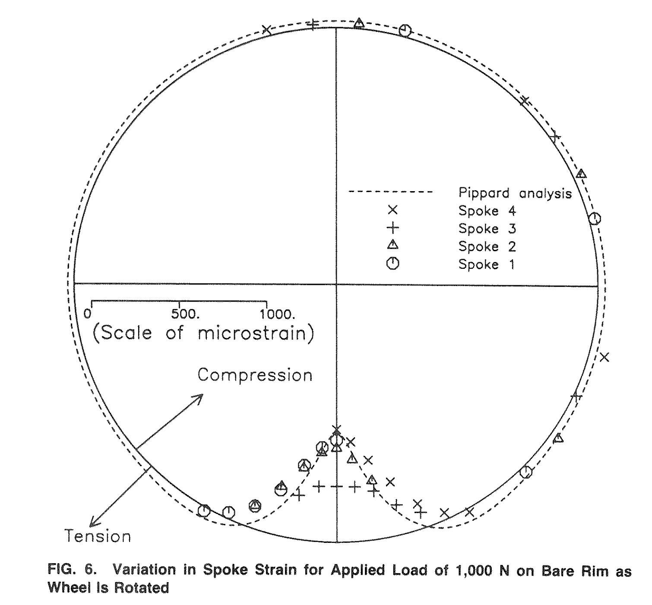
Bicycle spokes principles
1. Avoid mechanical work demand:
keep force perpendicular to velocity
2. Avoid mechanical work demand from the components:
don’t change length
3. Simple control:
let changes in geometry load and unload spokes
Pippard and Francis, 1931
Burgoyne and Dilmaghanian, 1993
Notes:
Note that the ‘wheel’ and ‘spoke’ functions can be understood without knowing the strain (stress) distribution. In fact, strain (stress) distribution of bicycle spokes quite unintuitive. Caution that even perfect measurement or simulation of strain (stress) distributions may not ‘reveal’ function.

Slide 10
Legs as linkages principles
1. Avoid mechanical work demand from the leg:
keep force perpendicular to velocity
2. Avoid mechanical work supply from muscles:
keep loaded muscles isometric
3. Simplify control:
let changes in geometry load and unload muscles
Notes:
Develop analogy between legs as work-avoiding sliders; bicycle spokes and work-avoiding muscles.

Slide 11
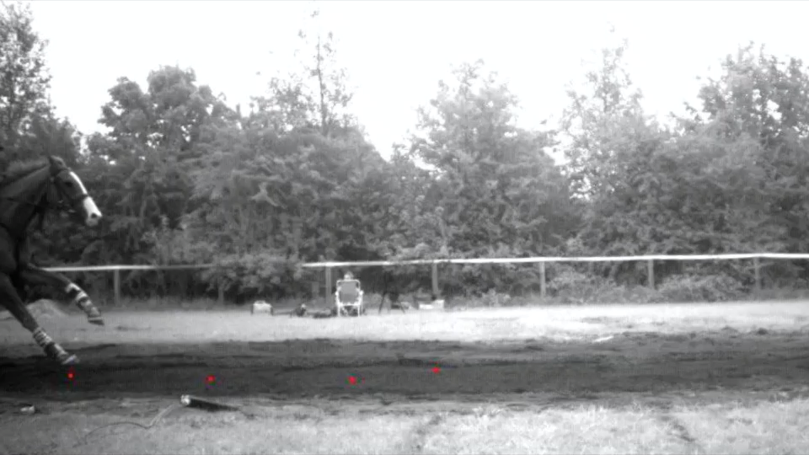
Using: Self Davies, Spence and Wilson, 2019. Biology Letters.
Measured force
Projected force
Notes:
Zoe’s PhD data showing that measured forces are very much more vertical than axial; to a large extent the body ‘slides’ over the foot with forces perpendicular to velocity (low mechanical power demand).

Slide 12
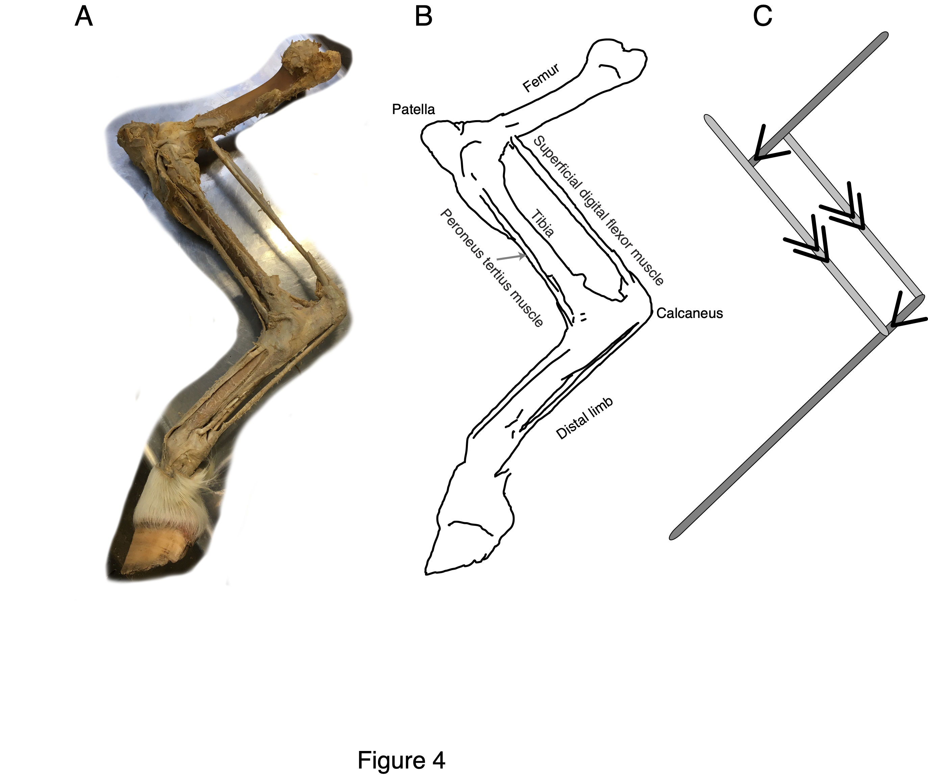
Notes:
Obvious distal 4-bar linkage

Slide 13
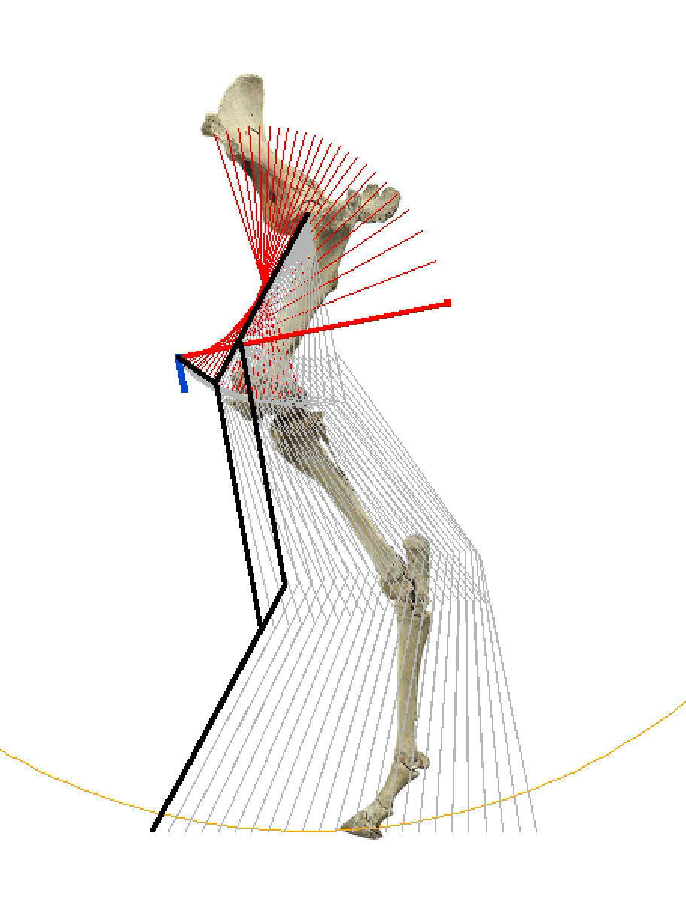
Notes:
Simulate what would be necessary for ‘perfect’ sliding, horizontal motion of foot, vertical forces; and how this could be supported by tension struts (putative muscle paths) while they don’t change length – so perpendicular to the instantaneous velocity vectors (blue)

Slide 14
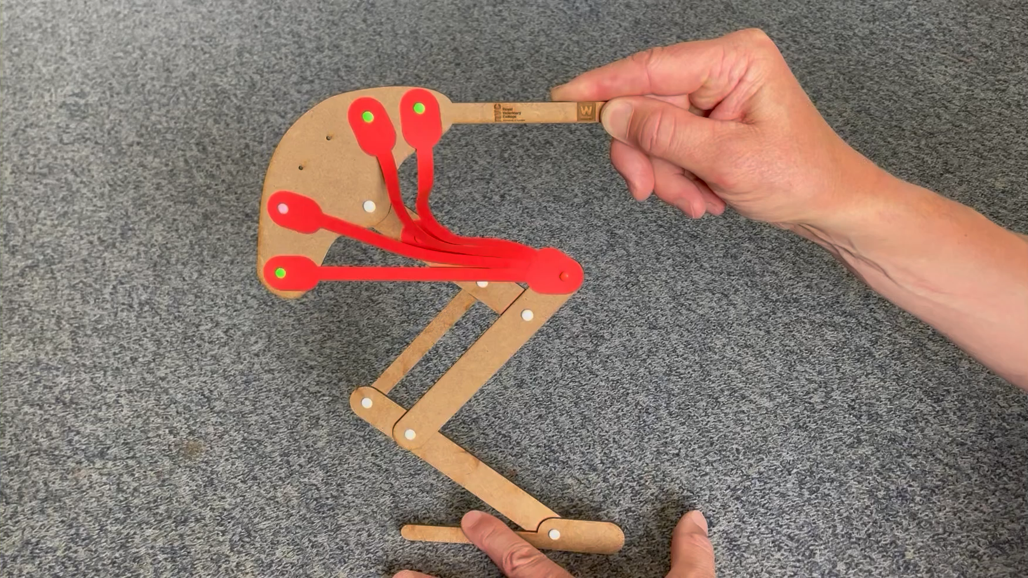
Movie of me operating the 6-bar demonstrator
Notes:
Paper-muscle model demonstrating geometric sequential loading and unloading during sliding motion.

Slide 15
Notes:
Return to fox hindlimb with many muscles inserting at the patella.

Slide 16
Features that reduce
work demand
Notes:
Return to work-avoiding features of bicycle.

Slide 17
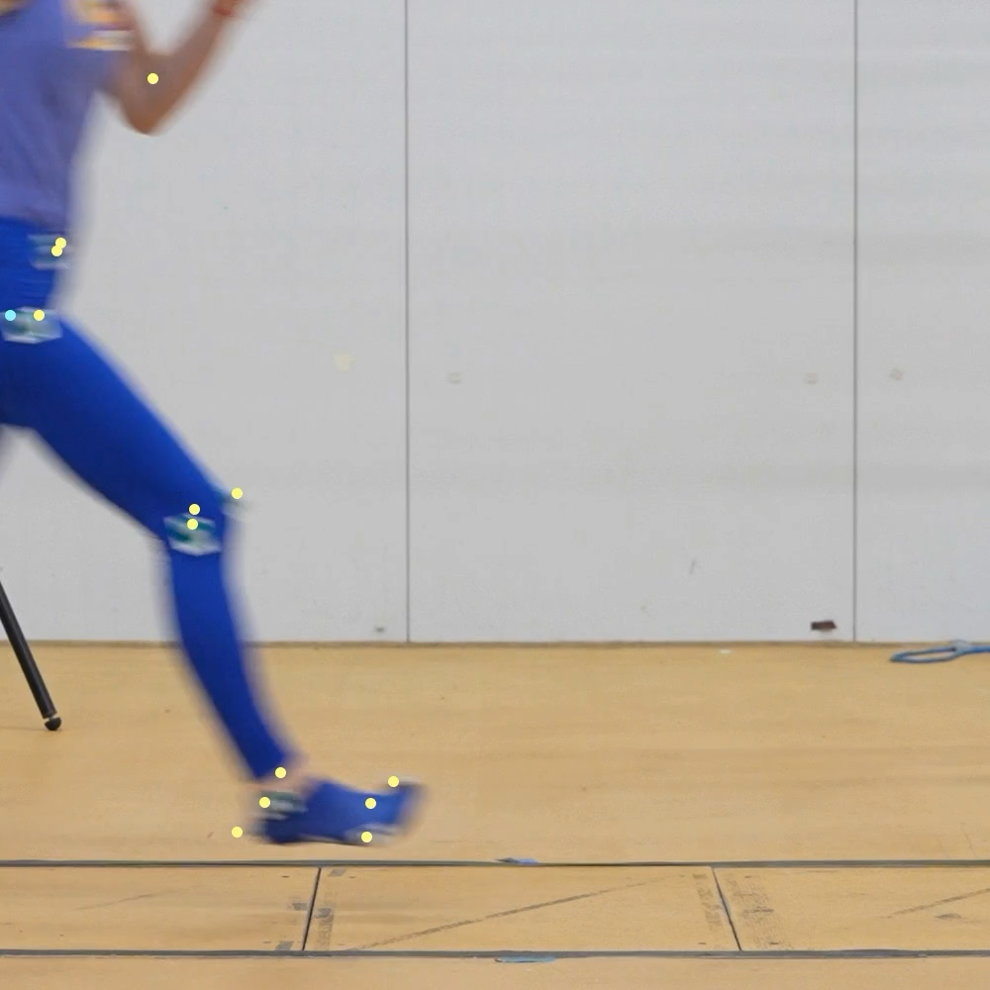
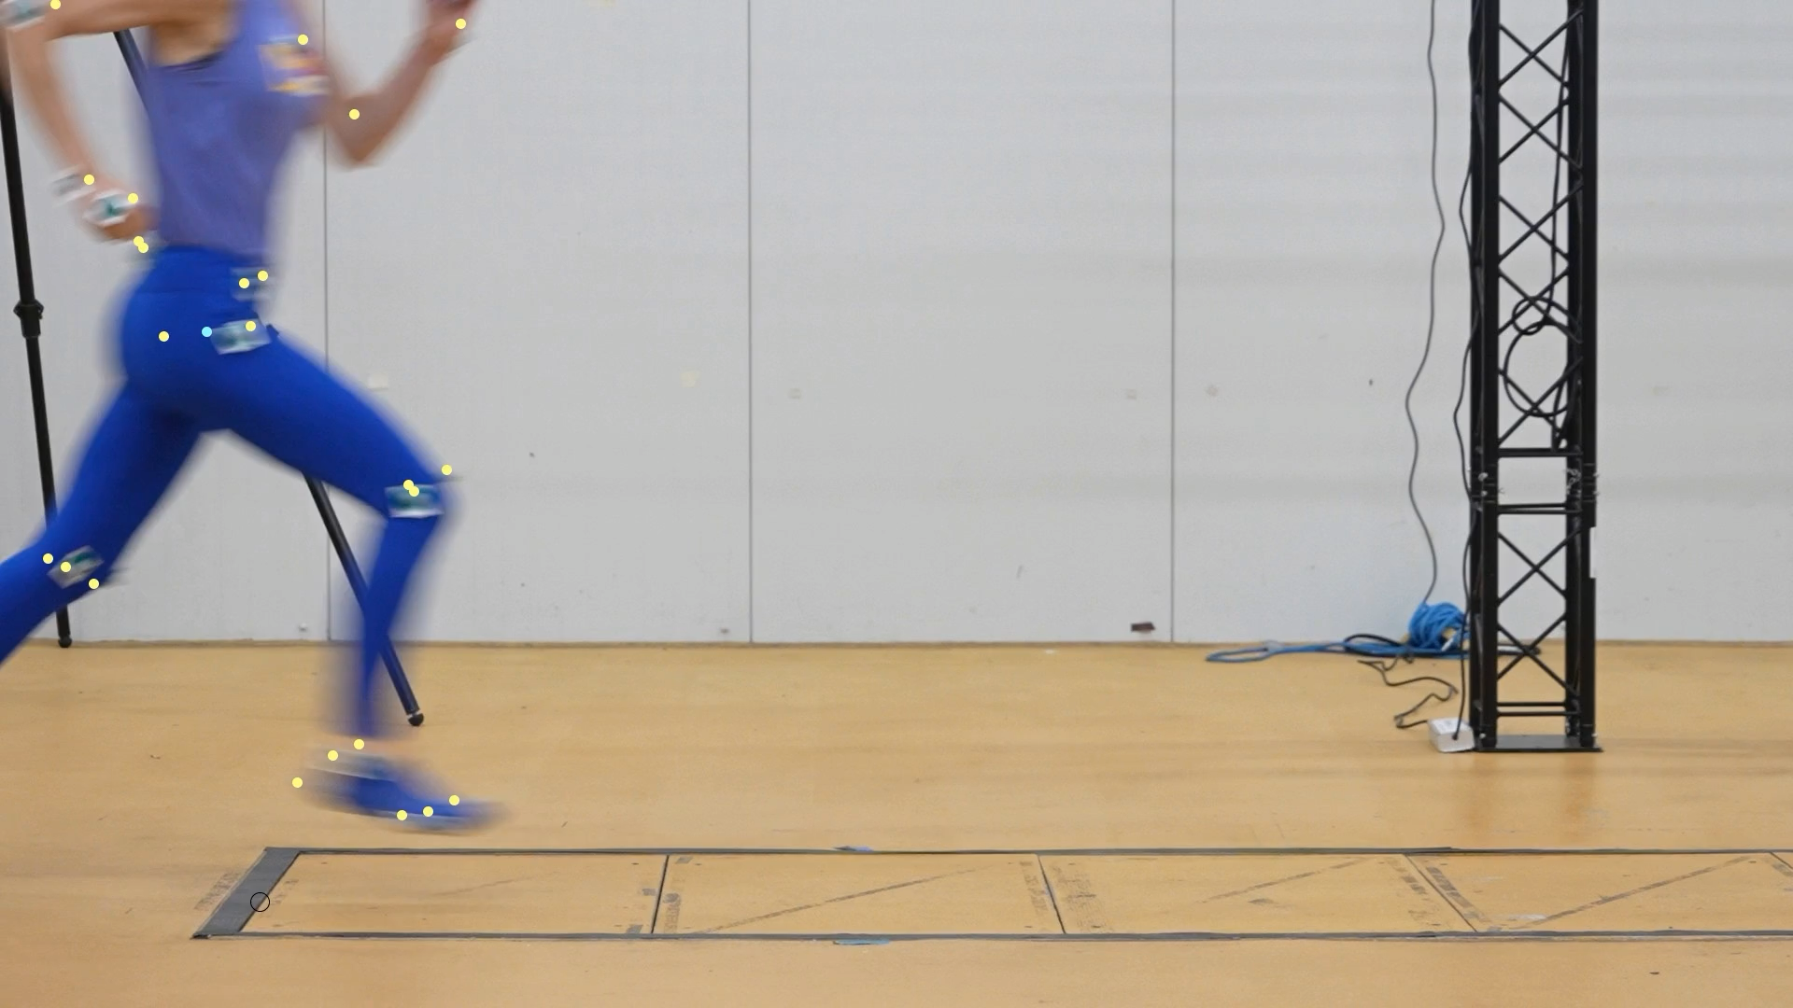
Work Avoidance Ratio = 30%
4.9 m/s
Notes:
Again ‘sliding’ weight support, this time in sprinting human. Note moments about hip.

Slide 18
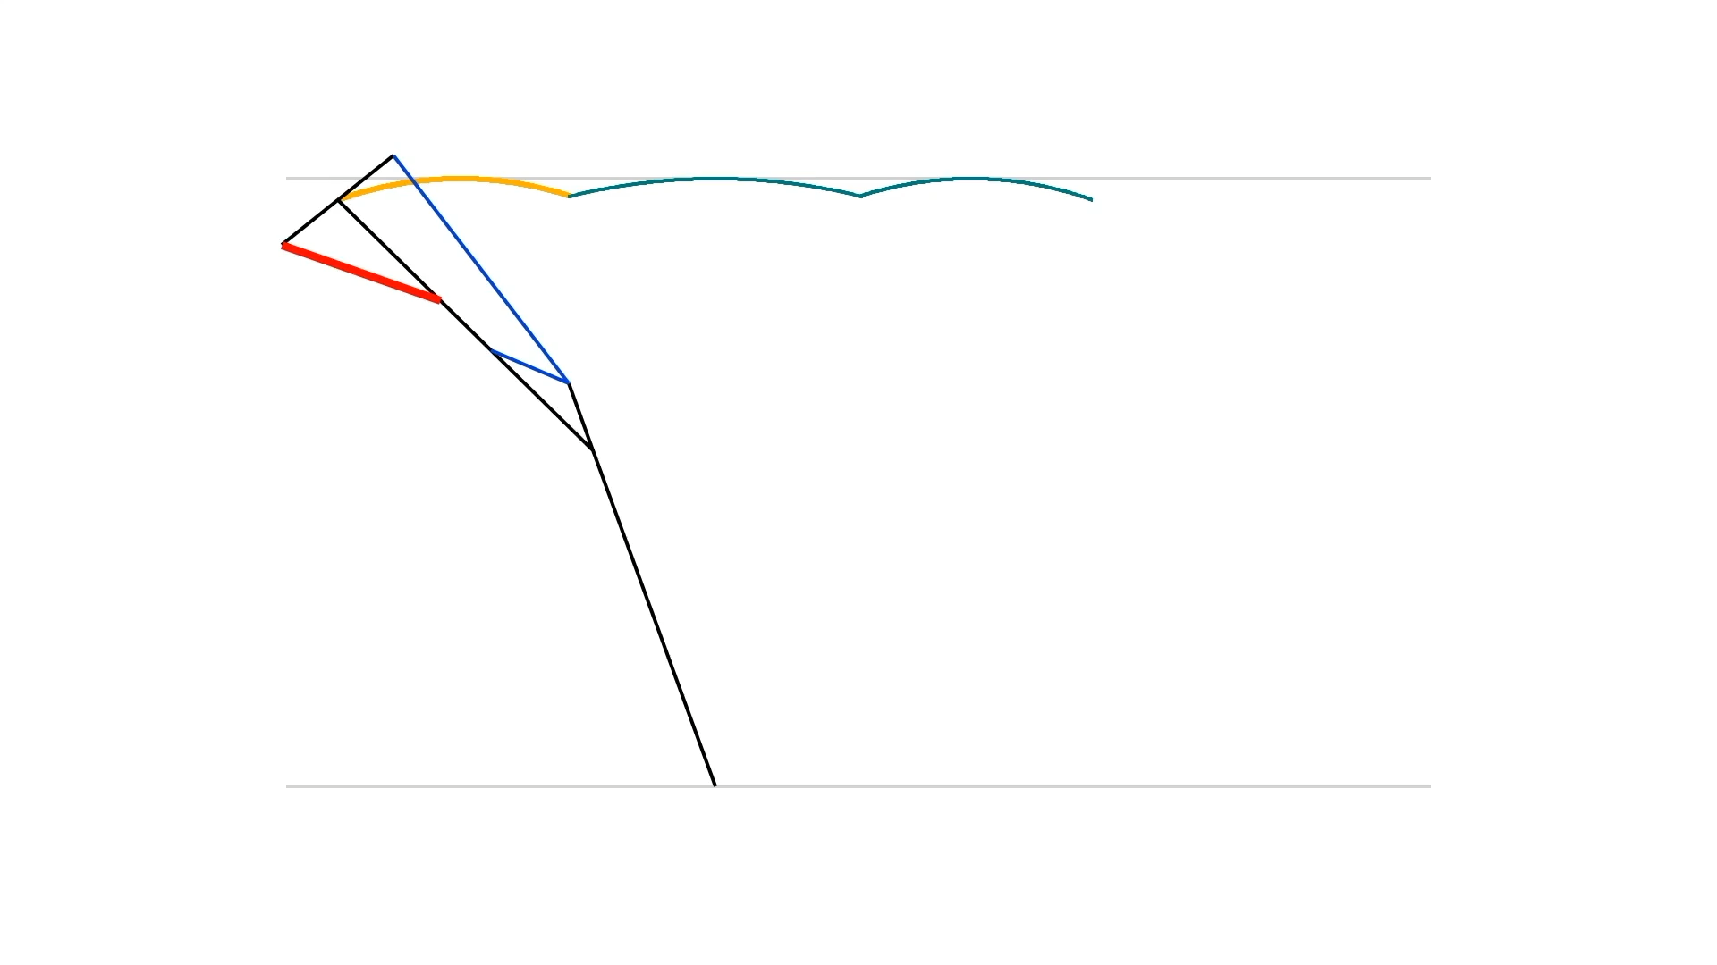
Notes:
Approximately horizontal motions supported by 3 simple linkages (gluteus, vastus, rectus femoris sequentially tensioned).

Slide 19

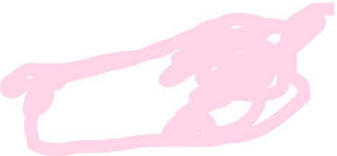
Features that reduce
work demand
Features that improve
economy of work supply
Notes:
Identify features of bicycle that enable economical work supply from muscle.

Slide 20

















Legs as linkages principles
MACHINES
1. Avoid mechanical work demand from the leg:
keep force perpendicular to velocity
2. Avoid mechanical work supply from muscles:
keep loaded muscles isometric
3. Simplify control:
let changes in geometry load and unload muscles
4. Perform mechanical work economically:
minimise mass of muscle per joule; maximise contraction period
Notes:
Transition from ‘legs as work avoiding linkages’ to ‘legs as machines’ – start to consider flow of work/power

Slide 21
Legs as linkages principles
MACHINES
1. Avoid mechanical work demand from the leg:
keep force perpendicular to velocity
2. Avoid mechanical work supply from muscles:
keep loaded muscles isometric
3. Simplify control:
let changes in geometry load and unload muscles
4. Perform mechanical work economically:
minimise mass of muscle per joule; maximise contraction period
4b. Without messing up 1-3
Notes:
Analogue: don’t let the pedaling influence the roundness of the work-avoiding wheels.

Slide 22
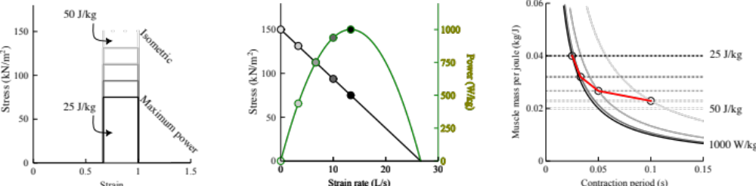
Notes:
Idealized muscle stress-strain, stress – strain rate, power – strain rate relationships show that a muscle at low strain rate can produce high work over a contraction, but low power; or a high power at intermediate strain rate requires reduced stress and so reduced work over the full contraction…

Slide 23
Notes:
Meaning that the muscle mass needing to be activated (which is physiologically costly) depends on the duration of contraction. A muscle with more time to contract could be smaller for a given work demand.

Slide 24
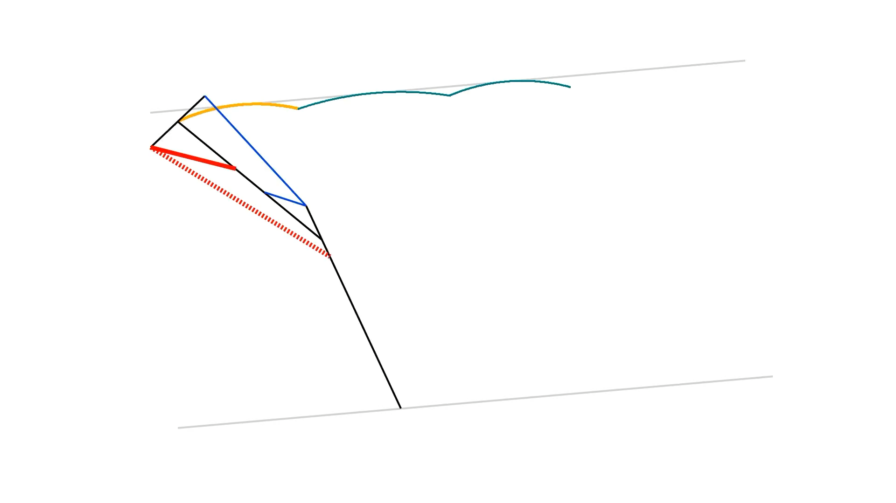
Notes:
How to contract over the entirety of stance without altering the work-avoiding geometry: tense a muscle that would be getting shorter anyway (hamstrings)

Slide 25
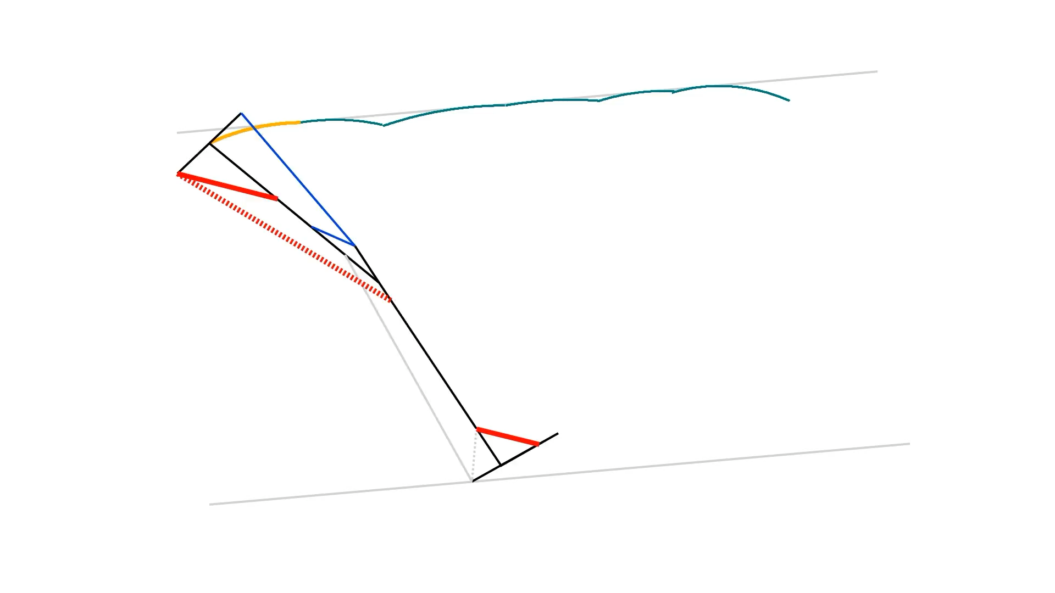
Notes:
Hamstrings still shorten anyway over whole of stance with a more complicated model (with ankle/foot) – path smoother with more joints.

Slide 26
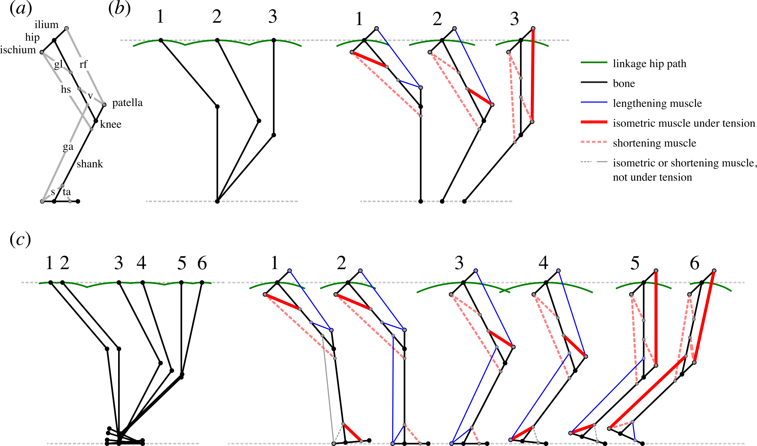
Lombard’s paradox?
Notes:
Potential functional account for ‘Lombard’s paradox’. Why are hamstrings and rectus femoris – which have opposing actions about both hip and knee joint – both active in late stance? Perhaps because function with discrete, complementary functions: hamstrings as economical motor (bicycle pedals/ gears); rectus femoris imposing work-avoiding geometry (bicycle spokes).

Slide 27
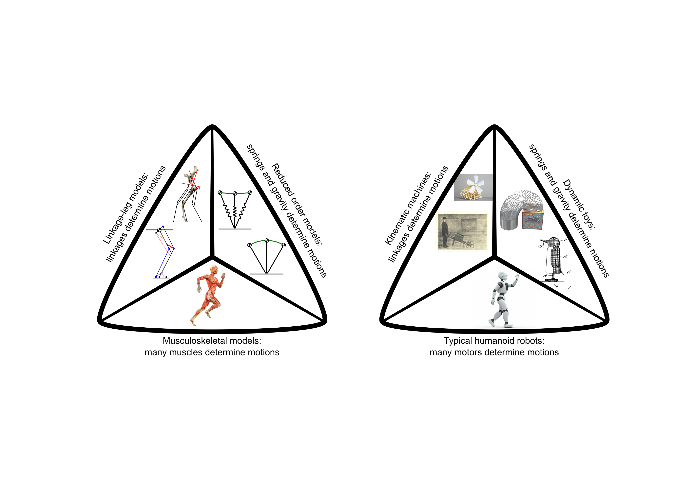
Notes:
Placement of ‘legs as linkages’ and ‘legs as machines’ in a broader context. Acknowledge linkage legs have been considered before (Chebshev, Jansen’s strandbeest).

Slide 28
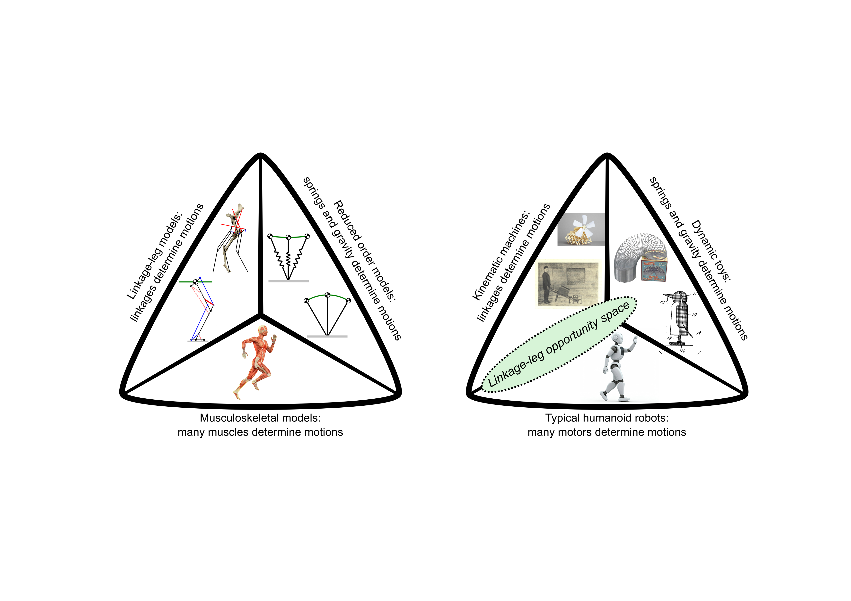
Notes:
Note new funder and plans to develop linkage-leg barrows to demonstrate/develop principles of economical weight support during translation, powering and unsensed, unpredicted terrain accommodation.

